Slide 1
Background
40 years working with top companies to achieve world class safety in their sector.
Classes: OSHA 10/30 Hour, Incident Investigation, Confined Space, Excavation Safety, Cranes Signaling, Rigging Safety, Fall Protection, Scaffold Competent Person, Silica Competent Person, CHST Prep, Lockout, Machine Guarding, OSHA Recordkeeping, and Safety Management
Services: Mock OSHA Inspections, Site Safety Audits, Expert Witness,
Since 1987, he has trained over 50,000 people including OSHA compliance officers and Fortune 500 Clients in numerous areas of Safety and Health.
815-354-6853 johnanewquist@gmail.com

Slide 3
Dust
Dust are solid particles that are formed by handling, crushing, grinding, drilling, or blasting of organic or inorganic materials.
Notes:
Example of dust particles are silica and grain dust.

Slide 4
Fumes
Fumes consists of very small fine solid particles in air that form when solid particles are heated to a high temperature, evaporate to vapor, and become solid again
Notes:
Example of fumes include lead fume and welding and brazing of metal which produce metal fumes.

Slide 5
Fibers
Solid particles whose length is several times greater than their diameter. Asbestos is an example.
Notes:
Fibers are commonly found in construction, mining, friction products and insulation materials.

Slide 6
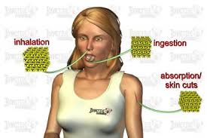
Routes of Entry
Inhalation
Ingestion
Skin Absorption
Injection
Notes:
In order to cause a harmful effect, chemical hazards in whatever form (dust, fume, gas, etc.) must come in contact with your body cells. These chemicals must enter your body either through inhalation (breathing), ingestion (eating or drinking), and absorption (through contact with the skin).
Inhalation is the primary route of entry for hazardous chemicals in the work environment. Nearly all materials that are airborne can be inhaled.
The respiratory system is the major route of exposure for airborne chemicals and dusts. Once air contaminants are inhaled into your respiratory system, they may harm the tissues of the respiratory tract or lungs; cause serious scarring; and/or be dissolved in the blood and transported throughout the body.
The most serious damage is caused by contaminants that penetrate deep into the lower regions of the lung. The upper regions of the respiratory system have strong defenses against inhaled contaminants.
Absorption through the skin is another route of entry. The skin is the largest organ of your body and a common exposure site for liquid and airborne chemicals. Absorption through the skin can occur quite rapidly if the skin is cut or abraded. Intact skin is an effective barrier to many hazardous materials.
Ingestion - toxic materials can be swallowed and enter the body through the gastrointestinal tract. In the workplace, people can unknowingly eat or drink harmful chemicals. For example, lead is frequently taken into the body by ingestion. You can ingest toxic materials when you eat, drink, or smoke in a contaminated work areas.
Injection occurs when a sharp object punctures the skin, allowing a chemical or infectious agent to enter your body. For example, injection can occur when a contaminated object such as a hypodermic needle punctures the skin. Injection is an infrequent route of exposure for chemicals in the industrial setting.

Slide 7
Respiratory System
The respiratory system is the major route of exposure for airborne chemicals and dusts.
Notes:
Once air contaminants are inhaled into your respiratory system, they may harm the tissues of the respiratory tract or lungs; cause serious scarring; and/or be dissolved in the blood and transported throughout the body.
The most serious damage is caused by contaminants that penetrate deep into the lower regions of the lungs.

Slide 8
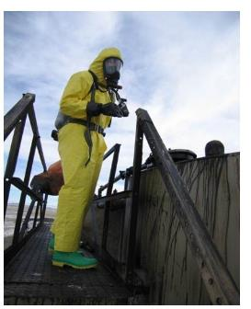
Acute Exposure
Acute exposures and acute effects generally involve short-term, high concentrations, and immediate or prompt health effects (illness, irritation, or death).
Notes:
The toxic action of a substance can be divided into acute (short-term) effects and chronic (long-term) effects. In addition to acute and chronic effects, we can distinguish acute and chronic exposures.
Acute exposures typically are sudden, of short duration, and are characterized by rapid absorption of the harmful material. For example, inhaling high levels of carbon monoxide or getting acid in your eye produces illness very rapidly. The health effect of a chemical exposure is considered “acute” when it appears within a short time following exposure, such as within minutes or hours, and the health effect is relatively short-lived.

Slide 9
Chronic Exposure
Chronic exposure refers to exposure continued or repeated for a prolonged period, usually years. For example, asbestosis.
Notes:
Chronic exposure may cause a substance to be continuously present in the tissues.
Chronic effects usually develop slowly. For example, if you breathe small amounts of asbestos fibers, you won’t even notice them. There are no acute effects. But if you inhale asbestos month after month, year after year, you greatly increase your changes of getting asbestos disease, such as lung cancer. This is a chronic effect.

Slide 10
Nov 2018

Slide 11
Clean Air Paradox
Quality of Air
78.1% Nitrogen
20.9% Oxygen
0.9% Argon
0.03% Carbon Dioxide

Slide 12
Units Seem Small
1 % = 10,000 ppm
PEL = Permissible Exposure Limits (OSHA)
5 Mg/M3 is very small
2 f/cc = 2,000,000f/M3
OSHA has said that following some PELs may not protect the workers.

Slide 13
Health Effects
Irritation
Asphyxiation
Organ Specific Effects
Mutagen
Teratogen
Acute/Chronic
Reversible vs. Nonreversible

Slide 14
Factors
Genetics
Age
Health status
Route of entry
Frequency and duration of exposure

Slide 15
Exposure Limits
Animal Studies
Epidemiological studies
Industrial Experience
STEL – 15 minutes
Ceiling – never exceeded
Threshold Limit Value
Notes:
Time-Weighted-Average is NIOSH 8 hour exposure limit.
STEL is the short term exposure limit.

Slide 16
Control of Health Hazards
Hierarchy of Controls
Engineering
Substitution
Work practices
Administrative
Personal protective equipment
Notes:
To control health hazards, the standard principles are: recognition, evaluation, and control. Once a potential hazard has been recognized, then its possible impact can be evaluated and effective control measures for the protection of employees can be developed and established.
Engineering, work practice, and administrative controls are the primary means of reducing employee exposure to health hazards.
When engineering controls and/or work practices are not feasible to, or while these controls are being installed or in emergencies, personal protective equipment must be used. Personal protective equipment is considered as the last resort to engineering, work practice and administrative controls.

Slide 17
Engineering Controls
Engineering controls include:
Substitution with less harmful material
Enclosure
Isolation
Ventilation - "Should be within two duct diameters for welding smoke."
Notes:
Engineering controls minimize employee exposure by either reducing or removing the hazard at the source or isolating the worker from the hazards.
Engineering controls include:
Eliminating toxic chemicals and replacing harmful toxic materials with less hazardous ones,
Enclosing work processes or confining work operations,
Installing general and local ventilation systems.

Slide 18
Ventilation

Slide 19
Administrative Controls
Administrative controls include:
Controlling employees' exposure by scheduling production and workers' tasks
Or both, in ways that minimize exposure levels
Notes:
Administrative controls include controlling employees' exposure by scheduling production and workers' tasks, or both, in ways that minimize exposure levels. For example: scheduling operations with the highest exposure potential during periods when the fewest employees are present.

Slide 20
Personal Protective Equipment
Personal protective equipment includes:
Respirators
Ear muffs
Gloves
Safety goggles
Helmets
Safety shoes
Protective clothing
Notes:
When engineering controls and/or work practices are not feasible to, or while these controls are being installed or in emergencies, personal protective equipment must be used. Personal protective equipment is considered as the last resort to engineering, work practice and administrative controls.
Personal protective equipment may include:
Respirators
Ear muffs
Gloves
Safety goggles.
Helmets
Safety shoes
Protective clothing
To be effective, personal protective equipment must be: individually selected; properly fitted and periodically refitted; properly worn; regularly maintained and replaced when needed.

Slide 21
What is Asbestos
A naturally occurring mineral
Added to building materials because of its good insulating, strength, sound-proofing, fireproofing and corrosion-resistance properties

Slide 22
What Is Asbestos
Asbestos is the name given to a group of naturally occurring
minerals used in certain products, such as building materials and vehicle brakes, to resist heat and corrosion.

Slide 23
Where did we get Asbestos?
It was mined underground.
Libby MT mine.

Slide 24
Asbestos
Libby MY
400 died
Thousands with respiratory issues
Notes:
Sarnia Canada high pockets of asbestosis

Slide 25
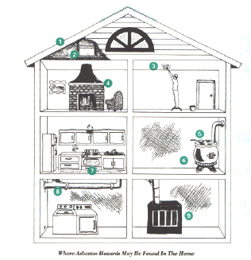
Examples of Asbestos Use
Shingles
Floor tiles
Asbestos cement
Roofing felts
Insulation & acoustical products
Steam pipes, boilers
“Popcorn” ceilings
Patching, joint compounds, textured paint, asbestos paper tape
Brakes, clutch facings
Plastics, fabrics, paints, paper

Slide 26
Asbestos

Slide 27
Asbestos

Slide 28
Asbestos

Slide 29
Asbestos

Slide 30
Asbestos

Slide 31
Lungs
Notes:
Air comes into our nasal passages, where it is cleaned and warmed
It travels down our trachea, where it is further cleaned
The trachea splits off into two bronchus, which lead into each lung
The bronchus then branch out into the bronchioles and then finally into the alveoli
Gas exchange actually takes place in the alveoli. Oxygen is deposited into the blood streaming through the lungs and carbon dioxide is removed from the blood. The oxygen is carried out to other parts of the bodies, and the carbon dioxide gets expelled as we exhale.
The main purpose of all of this branching is to increase the surface area along which this gas exchange can occur.

Slide 32
Lungs’ Defense Mechanisms
Notes:
Lungs have 2 defense mechanisms against foreign particles
Cilia vibrate continuously and in unison.
Move small particles, which become entrained in the mucous, up the trachea where they can be swallowed or expelled through coughing
Located in the nose, nasal passages, trachea and bronchi
Smoking temporarily paralyzes the cilia
Permanent after repeated exposures to smoking. Defense mechanism is replaced by an increase in coughing which is not as efficient.

Slide 33
Lungs’ Defense Mechanisms
Notes:
2nd mechanism are white blood cells known as macrophages
Surround particles and bring them to surface of trachea where they can be carried out by the cilia
Usually very efficient in cleaning out lower portion of lung
Asbestos fibers are sharp and can rupture the macrophages. The fibers then become embedded in the lung tissue causing irritation and leading to scarring.
Walls of the alveoli lose their elasticity and useful function in respiration.

Slide 34
Why is Asbestos a Health Hazard?
Asbestos is made up of microscopic bundles of fibers.
These fibers get into the air and may become inhaled into the lungs, where they may cause significant health problems.
Researchers still have not determined a “safe level” of exposure

Slide 35
Health Issues
Asbestosis a lung disease was first found in naval shipyard workers.
As asbestos fibers are inhaled, they become trapped in the lung tissue.
The body tries to dissolve the fibers by producing an acid.
This acid, due to the chemical resistance of the fiber, does little to damage the fiber, but may scar the surrounding tissue.
Eventually, this scarring may become so severe that the lungs cannot function.
The latency period is often 25 - 40 years.

Slide 36
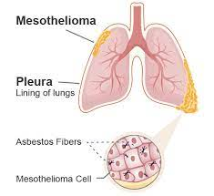
Health Issues
Mesothelioma:
a cancer of the pleura ( the outer lining of the lung and chest cavity) and/ or the peritoneum ( the lining of the abdominal wall).
This form of cancer is peculiar because the only known cause is from asbestos exposure.
The latency period for mesothelioma is often 15-30 years.

Slide 37
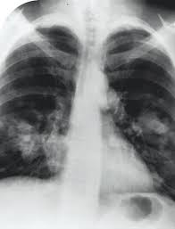
Health Issues
Lung Cancer:
Asbestos is a contributing factor of lung cancer.
The effects of lung cancer are greatly increased by cigarette smoking (by about 50%).
Cancer of the gastrointestinal tract can also be caused by asbestos.
The latency period for cancer is often 15-30 years.

Slide 38
1960s
The Snowmen

Slide 39
EPA
The purpose of the Asbestos National Emission Standard for Hazardous Air Pollutants (NESHAP) Program is to protect public health from exposure to regulated asbestos-containing material (RACM) during NESHAP facility renovation/demolition activities, asbestos removal, transport and disposal, closely monitoring those activities for proper notification and asbestos emissions control
Ambler PA Superfund

Slide 40
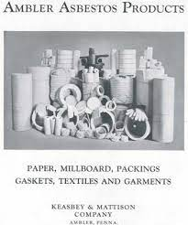
Asbestos
Ambler PA
Marilyn Amento’s Joe Jr. dad died from environmental exposure in the town's air in 2015
Notes:
Sarnia Canada high pockets of asbestosis

Slide 41
EPA
Under Section 112 of the Clean Air Act (CAA), Congress gave the U.S. Environmental Protection Agency (EPA) the responsibility for enforcing regulations relating to asbestos renovations and demolitions activities.
The CAA allows the U.S. EPA to delegate this authority to state and local agencies.

Slide 42
1973
In 1973, under the EPA's Clean Air Act, most spray-applied asbestos products were banned for fireproofing and insulating purposes.

Slide 43
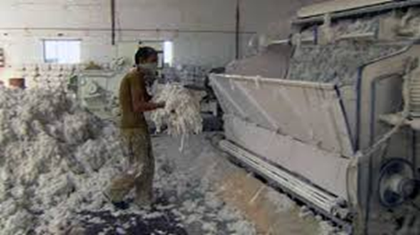
Asbestos
1918 A Prudential Insurance Company official notes that life insurance companies will not cover asbestos workers, because of the "health-injurious conditions of the industry."
In 1933, Metropolitan Life Insurance Co. doctors found that 29% of workers in a Johns-Manville plant had asbestosis.
Notes:
Almost 4.3 million Americans worked in shipyards during the war. Fourteen of every 1,000 of these shipyard employees died of asbestos–related cancer and an unknown number died of asbestosis, according to the Richmond Times–Dispatch (May 12, 2001).

Slide 44
History of Standards
Consensus Standards
ACGIH 1946 MAC’s
Bureau of Mines 1954
OSHA 1970
Notes:
Regulatory oversight on chemicals focused on cancer causing materials like asbestos.
The ACGIH (American Conference of Governmental Industrial Hygienists) developed a list of 148 maximum allowable concentrations (MACs) in 1946.
The Bureau of Mines started enforcing health standards in 1954.

Slide 45
Asbestos
OSHA
Must comply with 1926.1101
1910.1001

Slide 46
Terms
Abatement: any operation that is designed to permanently remove asbestos-containing materials.

Slide 47
Terms
Asbestos Hazard Emergency Response Act (AHERA): this act became law in 1987 and specified a plan by which K-12 schools would manage asbestos.

Slide 48
Terms
Asbestos-Containing Material (ACM): any material that contains more than 1% of asbestos.

Slide 49
Terms
Asbestos related work: any work that involves ACM and may result in the release of any quantity of asbestos fibers into the air.

Slide 50
Terms
Disturbance: contact with any material that contains ACM or PACM that causes release of fibers.

Slide 51
Terms
Fiber: a particulate form of asbestos, 5 micrometers or longer, with a length-to-diameter ratio of at least 3-to-1.

Slide 52
Terms
Fiber:
Greater risk if fiber’s size is greater than 5 microns (1 inch = 25,000 microns)
Most fibers removed from lungs within a few hours.
Long and/or thin fibers, particularly in the deepest parts of lung may stay for years or may never be removed.
.

Slide 53
Terms
Friable -Asbestos-containing material can be crushed with hand pressure

Slide 54
Terms
Intact: ACM that has not crumbled, been pulverized, or otherwise deteriorated.

Slide 55
Terms
Presumed Asbestos-Containing Material (PACM): materials that may contain asbestos but have not yet been tested.

Slide 56
Terms
Removal: all operations where ACM and/or PACM is taken out or stripped from structures or substrates, including demolition operations.

Slide 57
Terms
Renovation: any operations that involves altering a facility or one or more facility components in any way.

Slide 58
December 2014
Evanston IL
$132,000 to six contractors
OSHA's inspection found that onsite asbestos consultant directed the HVAC contractor to cut and remove 60 feet of piping that contained asbestos insulation without PPE.
Typical asbestos pipe.

Slide 59
Asbestos
OSHA 0.1f/cc
EPA-recommended clearance criteria for reoccupancy into work area following asbestos abatement, often cited as 0.01 f/cc.

Slide 60
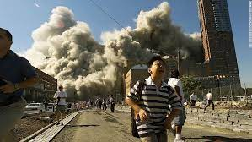
Twin Towers
Marcy Borders
1973-2017

Slide 62
Asbestos
3000 die in the US
Some are spouses or kids of asbestos workers
Stephanie Harper of the North Texas city of Bonham
Notes:
Dr sugar Baker Boston asbestos

Slide 63
Asbestos
Tony Rich fibers like ceramic wools rockwool all collect.
Can usually tell asbestos

Slide 64
May 2018
A California jury has awarded $11.4 million at the conclusion of a take-home asbestos exposure trial, finding that the defendant had acted with malice when it failed to warn employees of asbestos-related hazards.
This suit was brought by tenants who allege they were exposed to asbestos

Slide 65
Asbestos
Heather Von St James – hugging Dad
Mike Mattmuller – dad ground asbestos brakes as a mechanic
Notes:
Mike 29. Out of breath. Surgery. Four years no disease. Dad no signs of asbestosis.

Slide 66
June 2014
The asbestos lawsuit that saw a $1 million award
Richard Rost has Mesothelioma
Defendants included Ford Motor Company (Ford), General Electric, Westinghouse and Ingersoll-Rand.
However, the latter three defendants settled with the plaintiffs out of court, before the trial had an opportunity to begin.
Overall, nearly 3,000 people are diagnosed with mesothelioma each year in the United States, which represents 0.02 percent of all U.S. cancer cases.
Notes:
http://www.asbestos.com/mesothelioma/death-rate.php

Slide 67
Jan 2016

Slide 68
Case Study #1
Aurora
White Powder from pipe Insulation
Hires 3 Homeless people for $60 each to remove it
Asbestos over the surfaces
Cited 2 Willful
Old Pipe insulation can contain asbestos

Slide 69
Case Study #2
Church notices tile in basement area peeling.
One of the members offers to remove it.
Mastic used to set it was asbestos complaint.
What should have been done?
Example of tile type used.

Slide 70
Case Study #3
Middle School
Employees on renovation job concerned about possible asbestos in dumper
Hi-flow pumps used
Asbestos abatement hired to clean it after notified
High Flow Pump
Asbestos on mastic, floor tile, and ceiling tiles.

Slide 71
#1 Most Cited
1926.1101(k)(9)(i)
The employer shall, at no cost to the employee, institute a training program for all employees who are likely to be exposed in excess of a PEL and for all employees who perform Class I through IV asbestos operations.
A training exercise.

Slide 72
#2 Most Cited
1926.1101(e)(1)
All Class I, II and III asbestos work shall be conducted within regulated areas.
Sample regulated area

Slide 73
#3 Most Cited
1926.1101(f)(2)(i)
a "competent person“ must conduct an exposure assessment immediately before or at the initiation of the operation to ascertain expected exposures during that operation or workplace.
Sample of a tile scraped to be tested.

Slide 74
#4 Most Cited
1926.1101(i)(1)
General. Protective clothing, such as coveralls or similar whole-body clothing, head coverings, gloves, and foot coverings for any employee exposed to airborne concentrations of asbestos that exceed the TWA and/or excursion limit.
Typical protective clothing.

Slide 75
#5 Most Cited
1926.1101(l)(2)
Waste disposal. Asbestos waste, scrap, debris, bags, containers, equipment, and contaminated clothing consigned for disposal shall be collected and disposed of in sealed, labeled, impermeable bags or other closed, labeled, impermeable containers.
Asbestos put into plastic bags.

Slide 76
#6 Most Cited
1926.1101(k)(3)(i)
Before work in areas containing ACM and PACM is begun; employers shall identify the presence, location, and quantity of ACM, and/or PACM therein pursuant to paragraph (k)(1) of this section.
Signs warning of Asbestos presences will need to be posted.

Slide 77
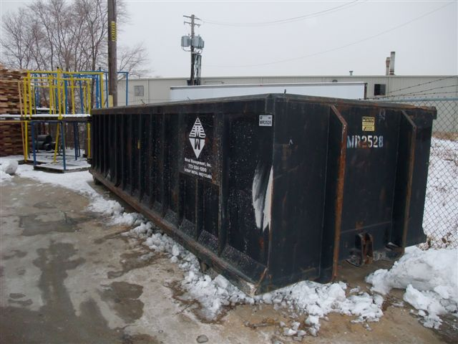
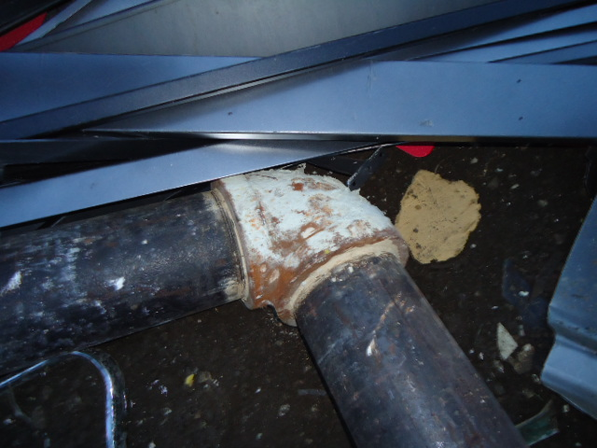
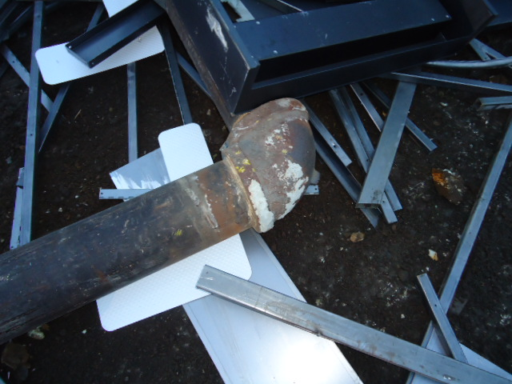
Case Study #5 Metal Container

Slide 78
Illinois EPA Involvement
12/10/10 IEPA went to company
Samples taken on piping, compactor and on floor – positive
12/17/10 referred to OSHA
Referred to Illinois States Attorney.
Cease and desist order
Court ordered remediation of facility shut down plant until IEPA deemed the area clean.

Slide 79
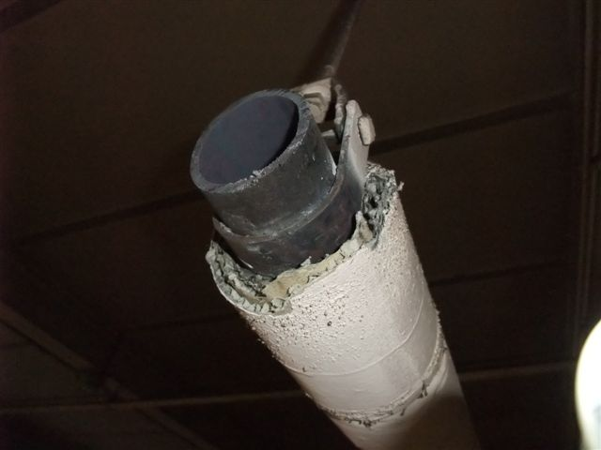
Pipe Insulation

Slide 80
OSHA Investigation
Based on interviews conducted
Safety consultant hired in 2002
CSP
Identified machine guarding and asbestos issues at facility.
Made specific recommendations to mgmt regarding asbestos.
Sent detailed report outlining specific asbestos safeguards to company management.
Virtually all recommendations were ignored by the employer.

Slide 81
Description of Events
Nov. 29 through Dec. 10, 2010, Plant Manager, directed five employees to remove and dispose of piping and heaters covered with asbestos containing insulation.
Only the Lead Man was told that the material contained asbestos
No one had been trained
Provided employees only with dust masks for protection.
Removed the pipes from the ceiling with reciprocating saw and brought them to the floor
Ripped-off the insulation with help of utility knives
Disposed of ACM/PACM in compactor for later disposal in a dumpster
Pipes placed in metal recycling bin
Dry swept the asbestos containing debris

Slide 82
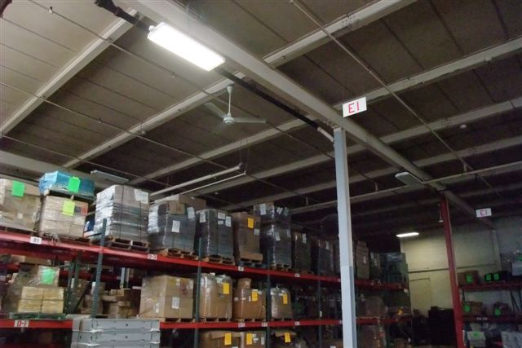
Area Removed
Boiler Room
removal

Slide 83
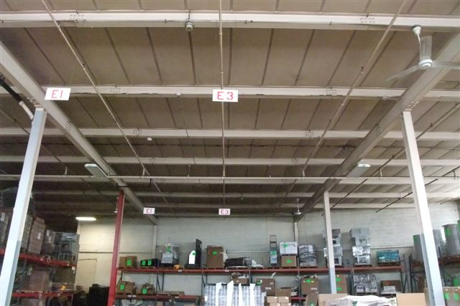
Area Removed
Pipe and heaters Removed

Slide 84
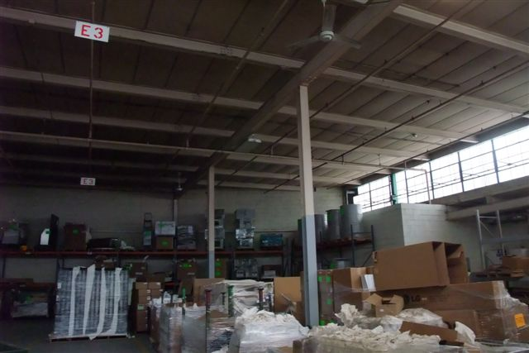
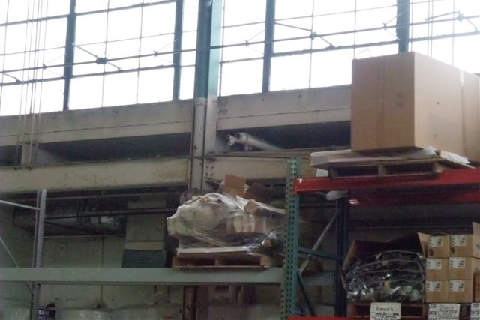
Area Removed
Pipes ran vertical to ceiling then toward the boiler room.
Boiler room
Pipe and heater removed

Slide 85
Photos – ACM Pipes

Slide 86
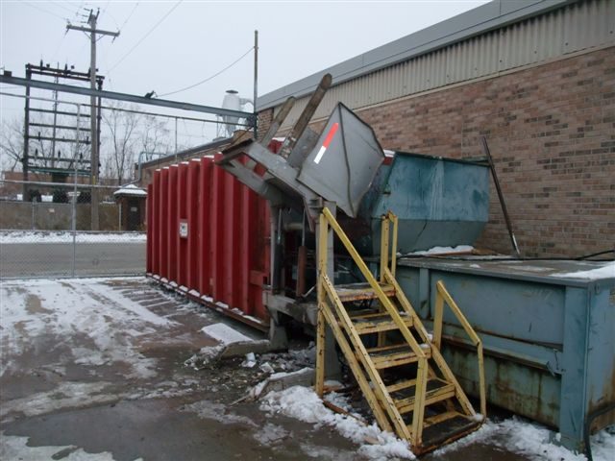
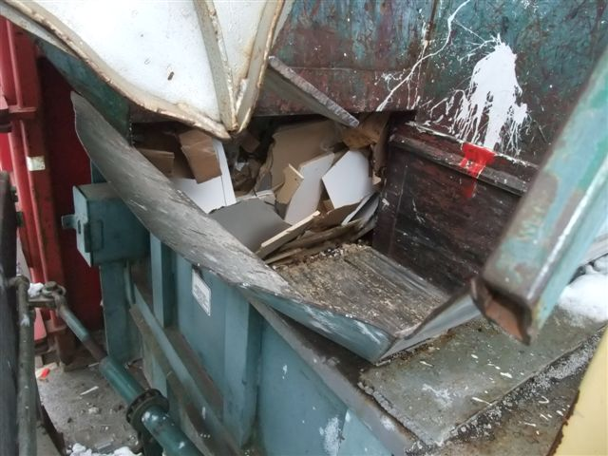
Compactor

Slide 87
Interviews - Management
Owner,
Authorized the work
to make the area more aesthetically appealing
the employees would have been laid off due to little work in the facility
Was aware of the ACM on the boiler
Plant Manager
Directed the work
Claimed awareness of ACM on the boiler but not the pipes

Slide 88
Interviews – Lead Man
Plant Manager told him the insulation contained asbestos
The employees conducting the removal were not instructed that the material was asbestos.
The employees dry swept and disposed of material were not instructed that the material was asbestos.
None of the employees were trained for asbestos work
Only provided with dust masks

Slide 89
Employer Knowledge of Facility’s ACM
Building built in 1951.
2002 - Consultant advised company of asbestos hazard
CSP
Initially hired to provide guidance on machine guarding problems
Saw potential asbestos containing material.

Slide 90
Heightened Knowledge of Regulation
Company asked CSP to test the material.
CSP relayed the positive ACM samples.
Discussed the options to manage and/or dispose of material.
Provided regulatory and training information to the Company.
June 2003 Company received a quote from a contractor for a boiler enclosure to be built.

Slide 91
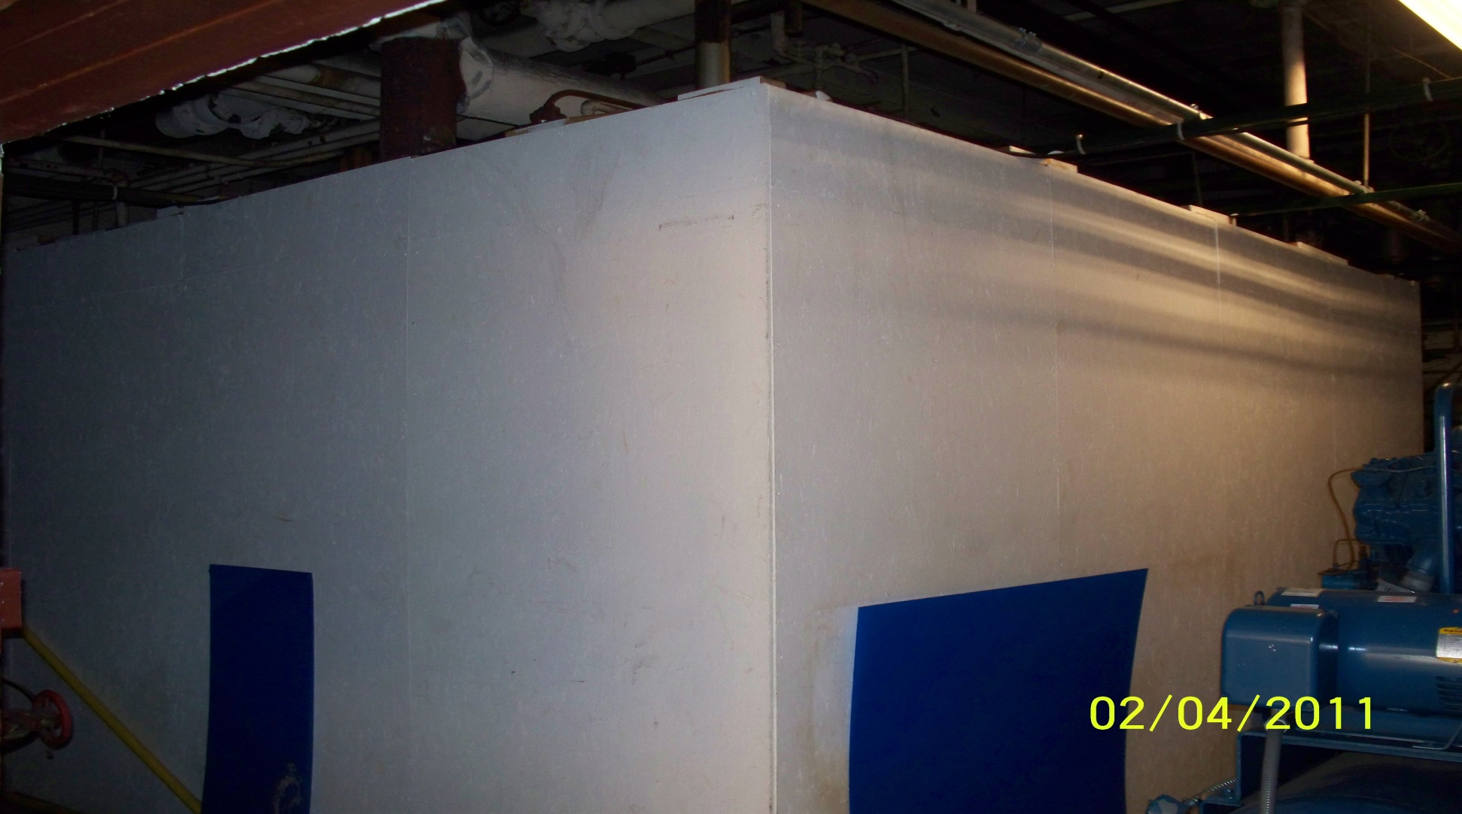
Photos- Enclosure

Slide 92
Enclosure Interior

Slide 93
Asbestos Repair on Boiler

Slide 94
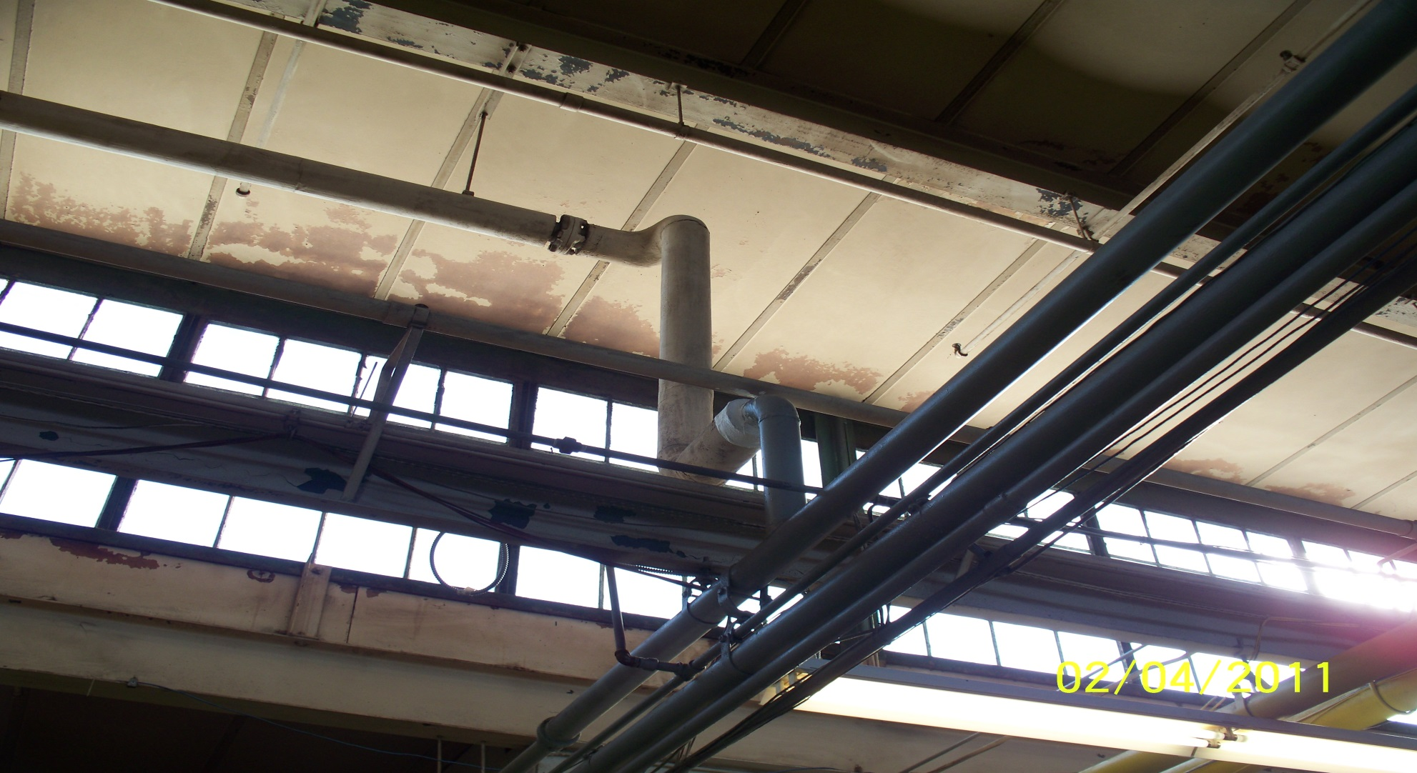
A Pattern of Disregard: Evidence of previous ACM removals

Slide 95
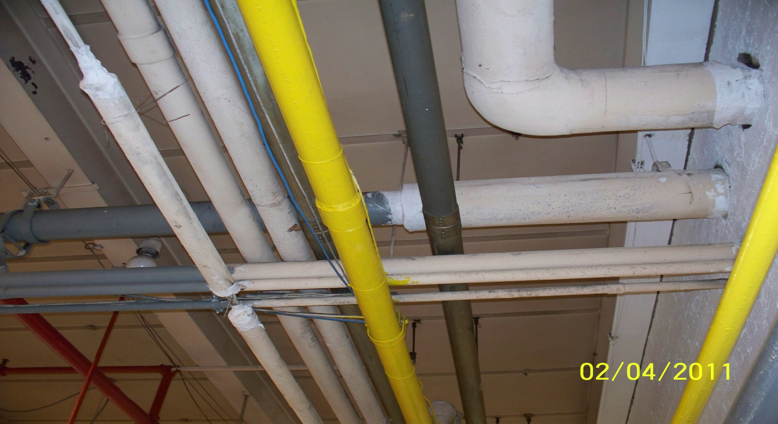
Other Removal

Slide 96
Why?
COST
Potential Removal Cost $250,000+
Paying for Asbestos permits.
Removal of ACM in facility by licensed contractor.
Disposal of ACM by legal means.
Not providing training, protective clothing, and respirators for employees.
If abatement contractor was used, facility might be shut down during work.
Halting production at facility.
Recycling of pipe and heaters

Slide 97
Summary of Violations
1926.1101 Asbestos
8 Serious ($50,400)
4 Willful ($252,000)
15 Egregious ($945,000)
TOTAL $1,247,400

Slide 98
Violations - Serious
1926.1101(e)(1)
Work in Regulated areas $6300
1926.1101(g)(2)
Exhaust, Ventilation $6300
1926.1101(g)(3)
Saws and Dry Sweeping $6300
1926.1101(g)(4)
Engineering Controls $6300
1926.1101(g)(5)
Negative Enclosure $6300
1926.1101(h)(2)
Respiratory Program $6300
1926.1101(j)(1)
Hygiene Facilities $6300
1926.1101(l)(2)
Proper Disposal $6300

Slide 99
Violations – Willful
1926.1101(f)(1)
Air Monitoring $63,000
1926.1101(f)(2)
Exposure Assessment Grouped
1926.1101(f)(3)
Daily Monitoring Grouped
1926.1101(g)(1)
Engineering Controls and Work Practices $63,000
1926.1101(k)(3)
Duty of employer to ID ACM $63000
1926.1101(k)(6)
Mechanical room identification of ACM $63000
1926.1101(k)(8)(vii)
Labeling Previous PACM or ACM Grouped

Slide 100
Violations – Willful Egregious
1926.1101(h)(1) & (h)(3)(i)[A]
Respiratory Protection $315,000*
1926.1101(i)(1)
Protective Clothing $315,000*
1926.1101(k)(9)(i)
Employee Training $315,000*
* $63,000 x 5 employee exposures

Slide 101
Total Violation Amount
8 Serious $50,400
4 Willful $252,000
3 Willful - Egregious $945,000
Total Penalty $1,247,400

Slide 102
2013
Franklin “Al” Bieri, 54, of Lebanon, Ill., was sentenced in federal court to five months in prison, followed by three months of home confinement.
Disposed in dumpster with no bagged or labels
Failed to notify Environmental Protection Agency at least 10 working days prior to beginning the asbestos work an offense punishable under the Clean Air Act.

Slide 103
2018
$1.8 million dollar fine to IL Roofer for OSHA violations for asbestos.
“This case stands out because of the outrageous behavior of Joseph Kehrer,” said Assistant Secretary of Labor for Occupational Safety and Health David Michaels.
Workers were threatened with firing if they spoke to investigators, Michaels said.

Slide 104
Baby Powder

Slide 105
Accidental Contact
Minor Contact:
(i.e. brushing up against PACM with small amount of fiber sticking to clothes)
DO NOT brush off or blow off PACM.
Remove PACM with wet rag or wet paper towel.
Wrap wet rag or wet paper towel containing PACM in another layer of wet rag or wet paper towel.
Dispose of rags and/or paper towels in sealed plastic bag
Use N100 Respirator

Slide 106
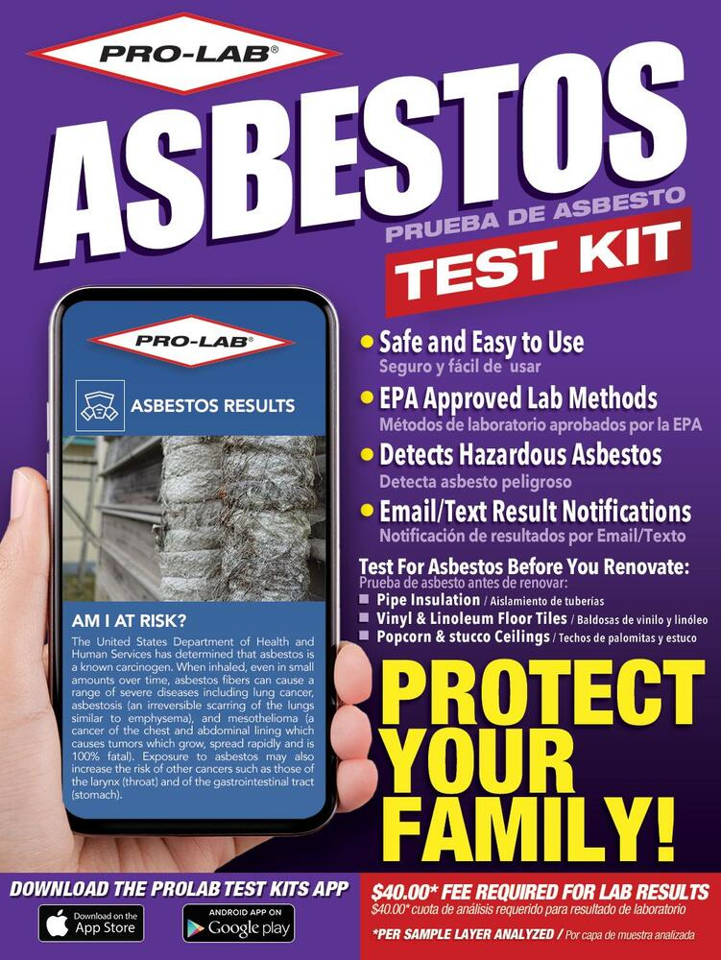
Accidental Contact
Major Contact:
Take measures to terminate contact with PACM.
Notify supervisor and Asbestos Coordinator and management.
Initiate testing procedure for PACM material contacted.
Change clothes and shower
Clothing may be bagged and remain sealed until testing procedure determines if ACM is present.
Use N100 Respirator and protective clothing

Slide 107
The Wives
Rachel
Alabama
One Lung Removed

Slide 108
Questions?

