Slide 1
TO 12: Describe requirements in 29 CFR 1910 Subpart H standards to protect workers from common hazards associated with hazardous materials.
EO 12.1: Describe common hazards associated with hazardous materials.
EO 12.2: Describe the requirements for compressed gas cylinders.
EO 12.3: Describe requirements for flammable and combustible liquid hazards.
EO 12.4: Explain basic requirements associated with process safety management.

Slide 2
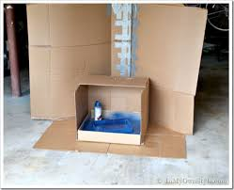
Subpart H Hazardous Materials
John Newquist
Draft 9 10 2023
Notes:
A cardboard spray booth is not acceptable. It must be made of noncombustible material.
There is no osha standards for pawder coating.

Slide 3
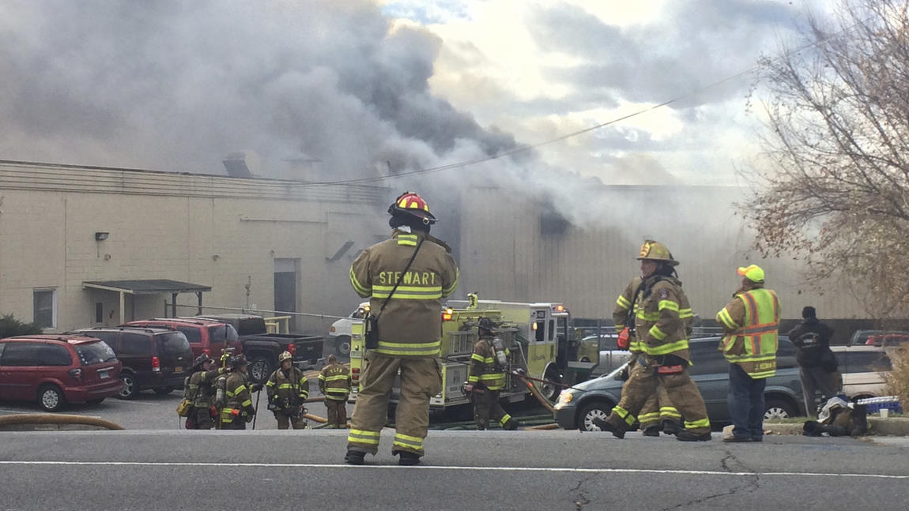
Nov 2017
New York cosmetics factory left 30 to 35 people injured, including seven firefighters caught in the second blast, officials said Monday.
"A deceased male employee was recovered from the plant fire at approximately 7:40 p.m
Police said the first explosion occurred around 10:15 a.m. Monday at the Verla International cosmetics factory in New Windsor, about an hour's drive from New York City. Firefighters who responded were inside when the second explosion occurred around 10:40 a.m.
Notes:
Cosmetics may be a combustible dust.
OSHA has standards for housekeeping and electrical. They would use a general duty clause violation for combustible dust under NFPA 654.
OSHA coded this as a dust explosion. They cited $63k and settled at $40.
1191945.015 inspection.

Slide 4
January 2014
According to OSHA records, it was first shift workers acting under supervision, who loaded the fateful batch of carbon and graphite parts, coated in a highly flammable alcohol and iodine solution.
The oven, unequipped to handle combustibles, exploded roughly 15 minutes later.
OSHA said the force ripped the oven’s door from its hinges, causing the heavy metal object to strike a group of three workers on a tour of the facility, 15 to 20 feet away.
The result is listed as “death and broken bones.”
The “event” oven – a Despatch-brand electric oven — had reportedly been purchased by the company to cure water-based calcium treatments roughly four years earlier.
Notes:
http://www.bradfordera.com/news/top_stories/article_1f9b396e-6566-11e4-9d7d-470fb392ada0.html
OSHA does not have coded for ovens and furnaces. They would NFPA 86 which is are safety guidelines for these devices.

Slide 5
Hydrogen
January 8, 2007 OHIO
The truck driver was delivering hydrogen gas to fill two 6500 cubic feet storage cylinders at the plant.
The hydrogen gas was used to cool the generator at the power plant.
At this time witnesses heard a loud noise, like high pressure gas venting through a relief valve, and within 15 to 20 seconds, the hydrogen gas exploded, killing the employee and injuring eight AEP coworkers.
The investigation revealed that the hydrogen gas over pressurized a rupture disk attached to one of the hydrogen cylinders.
As the set pressure of the rupture disk was between 3500 and 4000 psi, and the maximum pressure that could have be put on the system during filling was 2600 psi, the rupture disk failed well below its designed pressure.
Notes:
At approximately 8:55 a.m. on January 8, 2007, an employee, a truck driver arrived at the American Electric Power (AEP) Muskingum River plant located in Waterford, Ohio. The truck driver was delivering hydrogen gas to fill two 6500 cubic feet storage cylinders at the plant. The hydrogen gas was used to cool the generator at the power plant. At approximately 9:22 a.m., the employer, who was working alone at the time, was in the final stages of filling the cylinders. At this time witnesses heard a loud noise, like high pressure gas venting through a relief valve, and within 15 to 20 seconds, the hydrogen gas exploded, killing the employee and injuring eight AEP coworkers. The investigation revealed that the hydrogen gas over pressurized a rupture disk attached to one of the hydrogen cylinders. As the set pressure of the rupture disk was between 3500 and 4000 psi, and the maximum pressure that could have be put on the system during filling was 2600 psi, the rupture disk failed well below its designed pressure. The release of hydrogen through the relief vent piping, which terminated outside above the roof, also caused the copper vent tubing to fail and burst apart at a 45 degree elbow below the roof, therefore releasing hydrogen gas under the roof. This allowed the gas to accumulate into a large cloud that subsequently ignited and exploded. The force of the explosion killed the employee and injured nine AEP workers in an adjacent building.
https://www.osha.gov/pls/imis/accidentsearch.accident_detail?id=200758365

Slide 6
Cont.
OSHA - $8500
On or about January 8, 2007, employees were exposed to a fire and/or explosion hazard from the ignition of hydrogen gas during the filling of hydrogen storage cylinders at Unit 5 of AEP's Muskingum River Plant.
Precautions were not taken to prevent the ignition due to,
-Failure to use non-sparking tools (crescent wrench) to open the hydrogen tube trailer main valve; and
Failure to shut off the engine of the tractor delivering the tube trailer.
A feasible and acceptable method of abatement would be to remove all potential ignition sources while transferring hydrogen gas from trailers to customer storage cylinders, including:
Use non-sparking tools while working on hydrogen gas equipment; and
Shut down the engine of the tractor before initiating the transfer of hydrogen gas from the tube trailer to the storage cylinders.
Notes:
This is the general duty clause violation
https://www.osha.gov/pls/imis/establishment.violation_detail?id=309178523&citation_id=01001

Slide 7
Cont.
$7 million to Truck driver Family
Mr. Brown explained the inner workings of hydrogen storage systems at power plants and noted specifically the inherent dangers in the defendant’s roof above its hydrogen system and its use of weak copper relief stacks.
He also described a similar explosion that occurred in December 2005 at a plant in Moundsville, West Virginia, which prompted safety recommendations that were not acted upon by either defendant.
Simply stated, to become a fire hazard, hydrogen must first be confined; however, because hydrogen is the lightest element in the universe, it is very difficult to confine. Industry takes these properties into account when designing structures in which hydrogen will be used.
The designs help hydrogen escape up and away from the user in case of an unexpected release
Notes:
Lawsuits do not have the 6 month statue that OSHA has.
A West Virginia jury has awarded $7 million in damages to the family of a worker killed in a 2007 explosion at an American Electric Power plant in Ohio.
A Marshall County jury found AEP and subsidiary Ohio Power Co. negligent in the death of Lewis Timmons of New Martinsville, The Intelligencer reported.
https://www.insurancejournal.com/news/southeast/2011/08/30/212861.htm

Slide 8
NFPA 2 - 2016
Hydrogen Technology Code
5.1.8 – operation and maintenance manual
5.1.11 – annual certification
5.1.12.2 PHA
5.2.2.2 Explosion Protection
5.4.3.1 H2 vessel burst scenario
5.4.3.2 H2 deflagration scenario
5.4.3.3 Hydrogen detonation scenario
6.4 Quantity Thresholds
6.8 Employee Alarm
6.12 H2 detection
6.13 approved lighting
6.17 Ventilation
6.19.3 Fire Protection
7.1.4.1.6 Container inspection
8.1.4 pressure relief
See also CGA G 5.3:2017
Commodity Specification For Hydrogen
Notes:
NFPA 2 is the industry standard for hydrogen.

Slide 9
October 2023
OSHA finds RM Palmer did not evacuate West Reading candy plant before gas leak explosion fatally injured 7 workers

Slide 10
Citation

Slide 11
Buffalo Rock
1988
4 dead
Bullet filling machine misfires.
Housekeeping
Electrical
Notes:
Buffalo rock was a gunpowder explosion in 1988 north of LaSalle IL.
A primer loading machine for bullets jammed triggering a dust explosion that killed 4 workers.

Slide 12
Hazardous Materials [1910.101 – .126]
Compressed Gases – Handling Storage and Use
SUBPART H
Spray Areas – Cleaning with Non-sparking Tools
Class I Liquids – Dispensing
Spray Booth – Air Velocity
Documentation of Equipment with good engineering practices
Notes:
The most citated items should be discussed in general.

Slide 13
1910.101(b)
"Compressed gases." The in-plant handling, storage, and utilization of all compressed gases in cylinders, portable tanks, rail tank cars, or motor vehicle cargo tanks shall be in accordance with Compressed Gas Association Pamphlet P-1-1965, which is incorporated by reference as specified in Sec. 1910.6.
Notes:
This is training objective EO 12.2: Describe the requirements for compressed gas cylinders.
This is test question 28 Which industry standard has OSHA incorporated by reference for handling, use and storage of compressed gases?
NFPA Publication 30
CGA Pamphlet P-1
ANSI Z87.1
ASTM Z10
https://law.resource.org/pub/us/cfr/ibr/003/cga.p-1.1965.pdf is a copy of the phamplet.
OSHA cannot cite the “should” provision in the phamplet.

Slide 14
Notes:
Sample citation shows how OSHA cites this standard.

Slide 15
Notes:
Sample citation shows how OSHA cites this standard.

Slide 16
Notes:
Sample citation shows how OSHA cites this standard.

Slide 17
Notes:
Sample citation shows how OSHA cites this standard.

Slide 18
Knowledge Check 28
Which industry standard has OSHA incorporated by reference for handling, use and storage of compressed gases?

Slide 19
Knowledge Check 28
Which industry standard has OSHA incorporated by reference for handling, use and storage of compressed gases?
CGA Pamphlet P-1

Slide 20
1910.107(g)(2)
Cleaning.
All spraying areas shall be kept as free from the accumulation of deposits of combustible residues as practical, with cleaning conducted daily if necessary.
Scrapers, spuds, or other such tools used for cleaning purposes shall be of nonsparking material.
What could be the weaknesses in citing this?
Notes:
#2 cited is for flammable paints. Water based paints do not leave a combustible residue.
The material must be grounded if using flammable paints.

Slide 21
1910.106(e)(2)(iv)(d)
Flammable liquids shall be drawn from or transferred into vessels, containers, or portable tanks within a building only through a closed piping system, from safety cans, by means of a device drawing through the top, or from a container or portable tanks by gravity through an approved self-closing valve.
Transferring by means of air pressure on the container or portable tanks shall be prohibited.
Notes:
1910.106(e)(2)(iv)(d) flammable liquids shall be drawn from or transferred into vessels, containers, or portable tanks within a building only through a closed piping system, from safety cans, by means of a device drawing through the top, or from a container or portable tanks BY GRAVITY THROUGH AN APPROVED SELF-CLOSING VALVE. Transferring by means of air pressure on the container or portable tanks shall be prohibited.
Who does OSHA recognize as an "approval" authority? Well OSHA calls them a Nationally Recognized Testing Laboratory (NRTL) and they are listed on OSHA's website. But for a flammable liquid valve that is a "self-closing valve" there are only a few NRTL's that OSHA recognizes that would "test and approve" such a device. A "deadman valve" should carry an FM approved or UL logo approval!.

Slide 22
Bonding and Grounding
OSHA’s flammable liquids standard, 29 CFR 1910.106, requires electrical interconnection when dispensing Category 1 or 2 flammable liquids or:
Dispensing Category 3 flammable liquids with a flashpoint below 100 degrees F
Notes:
This is training objective EO 12.3: Describe requirements for flammable and combustible liquid hazards.
This is test question #26
OSHA’s flammable liquids standard, 29 CFR 1910.106, requires electrical interconnection when dispensing Category 1 or 2 flammable liquids or:
Transporting propane and other liquefied gases
Storing flammable liquids for more than one shift
Dispensing Category 3 flammable liquids with a flashpoint below 100 degrees F
Working with Category 4 liquids within 20 feet of combustible materials
To understand the OSHA requirements for the safe storage of flammables, we must first define flammable. The flashpoint and boiling point determine the category of a flammable liquid. Flashpoint is the minimum temperature at which a liquid gives off enough vapor to form an ignitable mixture with air near the surface of the liquid.
A flammable liquid is any liquid having a flashpoint at or below 199.4°F (93 °C). Flammable liquids are divided into four categories:
Category 1: Liquids with flashpoints below 73.4°F (23°C) and boiling points at or below 95°F (35°C) (1910.106(a)(19)(i)). Examples: acetaldehyde and ethyl ether.
Category 2: Liquids with flashpoints below 73.4°F (23°C) and boiling points at or above 95°F (35°C) (1910.106(a)(19)(ii)). Examples: acetone, benzene and toluene.
Category 3: Liquids with flashpoints at or above 73.4°F (23°C) and at or below 140°F (60°C). When a Category 3 liquid with a flashpoint at or above 100°F (37.8°C) is heated for use to within 30°F (16.7°C) of its flashpoint, it must be handled in accordance with the requirements for a Category 3 liquid with a flashpoint below 100°F (37.8 °C) (1910.106(a)(19)(iii)).
Category 4: Liquids having flashpoints above 140°F (60°C) and at or below 199.4°F (93°C). When a Category 4 flammable liquid is heated for use to within 30°F (16.7°C) of its flashpoint, it must be handled in accordance with the requirements for a Category 3 liquid with a flashpoint at or above 100°F (37.8°C) (1910.106(a)(19)(iv)). When a liquid with a flashpoint greater than 199.4 °F (93 °C) is heated for use to within 30 °F (16.7 °C) of its flashpoint, it must be handled in accordance with the requirements for a Category 4 flammable liquid (1910.106(a)(19)(v)).
Whether liquids are Category 1 or 4 is not the only factor you should consider when determining safe storage needs. You also need to consider ignition temperature, lower and upper explosive limits (LEL or UEL), vapor pressure, specific gravity and vapor density when designing a storage system.

Slide 23
September 2014
Notes:
Class Participation
This is a 5 gallon drum of thick flammable adhesive. They used an airline to push the liquid.
What the hazards?
No self closing valve
Use of air pressure
No grounding
No bonding cable available

Slide 24
2017

Slide 25
Ether accident
Drop filling
Worker sees sparks in funnel
Next thing he knows he is on fire with invisible flames
Notes:
Drop filling is very hazardous. Static electricity will be generated. A spark can ignite the vapors. This is should be piped in or use of a transfer pump. Bonding must be done.

Slide 26
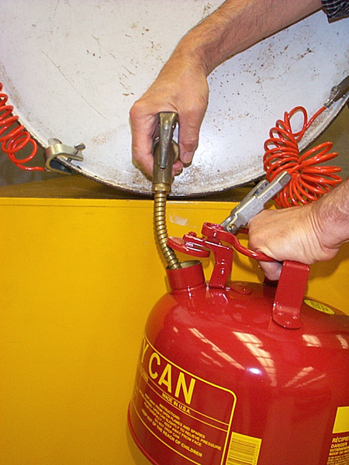
Self-Closing Safety Faucet
Bonding wire between drum and container
Grounding wire between drum and ground
Safety vent in drum
Notes:
This is a good setup. Self closing faucet, bonding cable used. Drum is grounded.

Slide 27
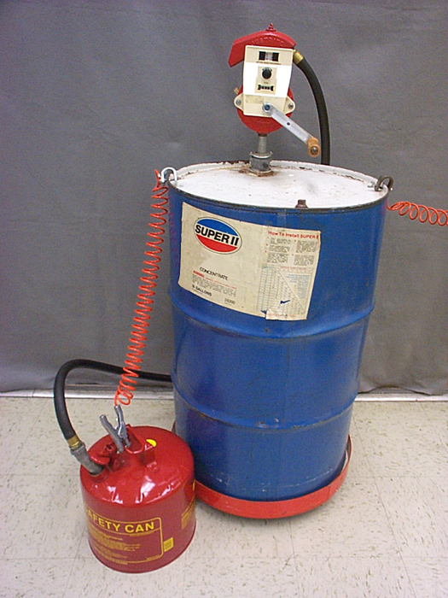
Safety Pump
Faster and safer than using a faucet
Spills less likely
No separate safety vents in drum required
Installed directly in drum bung opening
Some pump hoses have integral bonding wires
Notes:
Safety pumps prevent overfilling. They are around $250. Proper bonding is shown.

Slide 28
Knowledge Check 26
OSHA’s flammable liquids standard, 29 CFR 1910.106, requires electrical interconnection when dispensing Category 1 or 2 flammable liquids or:
Storing flammable liquids for more than one shift
Dispensing Category 3 flammable liquids with a flashpoint below 100 degrees F

Slide 29
Knowledge Check 26
The lower flammable limit of a flammable gas or vapor is the:
Highest concentration of the gas or vapor in air, expressed as a percentage, that can be ignited
Lowest concentration of the gas or vapor in air, expressed as a percentage, that can be ignited

Slide 30
Knowledge Check 26
The lower flammable limit of a flammable gas or vapor is the:
Highest concentration of the gas or vapor in air, expressed as a percentage, that can be ignited
Lowest concentration of the gas or vapor in air, expressed as a percentage, that can be ignited

Slide 31
1910.107(b)(5)(i)
The spraying operations except electrostatic spraying operations shall be so designed, installed and maintained that the average air velocity over the open face of the booth (or booth cross section during spraying operations) shall be not less than 100 linear feet per minute.
Notes:
A velometer is used to measure the speed across the booth. Booth should have a guage to indicate the speed.

Slide 32
1910.119(d)(3)(ii)
The employer shall document that equipment complies with recognized and generally accepted good engineering practices.
Notes:
This is training objective EO 12.4: Explain basic requirements associated with process safety management.
What is the OSHA PSM standard?
As a result, OSHA developed the Process Safety Management (PSM) standard (issued in 1992), which covers the manufacturing of explosives and processes involving threshold quantities of flammable liquids and flammable gasses (10,000 lbs), as well as 137 listed highly hazardous chemicals.

Slide 33
1910.119(d)(3)(ii)
Ammonia Compressor Room
Photo Bryan Haywood
Notes:
The purpose of the PSM standard is to prevent or minimize the consequences of an uncontrolled release from a workplace process containing a threshold quantity or greater amount of highly hazardous chemicals such as 10,000 pounds or more of NH(3). As discussed in the background section on page 6356 of the preamble to the PSM Final Rule, there exists a potential for an accidental release if a HHC is not properly controlled, regardless of the industry. Thus, the PSM standard is aimed not only at the petrochemical industry as stated in your letter but also at other industries, irrespective of size, at which there are processes containing HHC's such as NH(3)
https://www.osha.gov/laws-regs/standardinterpretations/1994-06-02#:~:text=The%20purpose%20of%20the%20PSM,more%20of%20NH(3).
Bulletin No. 111. Guidelines for Ammonia Machinery Room Ventilation. IIAR Ammonia Refrigeration Library, (1991, October). Major differences can be found between codes when determining ventilation requirements for ammonia machinery rooms. This bulletin cuts through the jargon and provides a practical ventilation design criteria that will satisfy existing code requirements and improve machinery room safety.
This room has no warning signs or alarms.

Slide 34
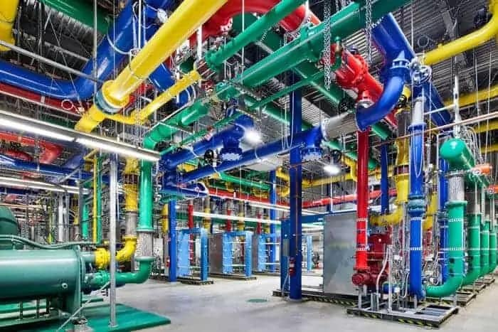
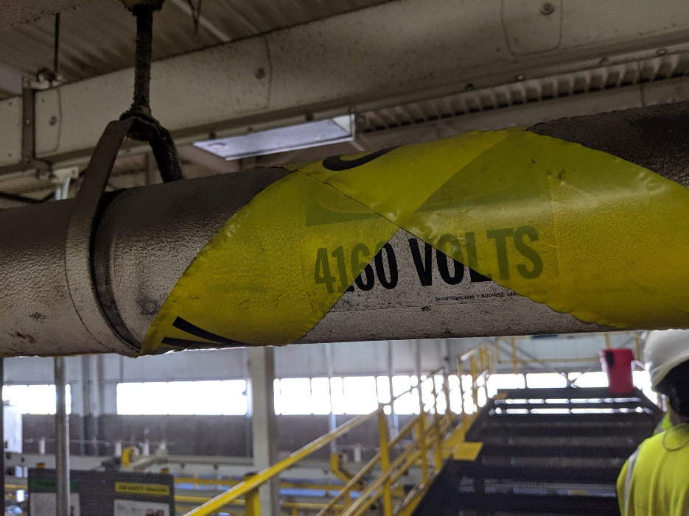
1910.119(d)(3)(ii)
OSHA considered, but rejected, publishing a list of RAGAGEP providers
The employer (not OSHA!) selects the applicable and protective RAGAGEP it will use / comply with!
Notes:
Pipes should be labeled to their contents. This is required by the ANSI B31 piping cones.
Color pipe is google data center cooling machine.

Slide 35
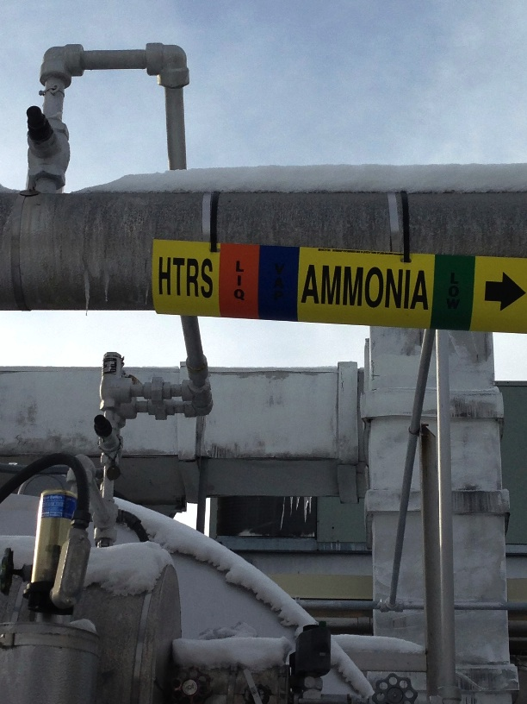
Potential Sources of RAGAGEP
Ammonia - IIAR (International Institute of Ammonia Refrigeration)
Bulletin 107 - Guidelines for: Suggested Safety and Operating Procedures when Making Refrigeration Plant Tie-Ins
Bulletin 108 - Guidelines for: Water Contamination in Ammonia Refrigeration System
Bulletin 109 - Guidelines for: IIAR Minimum Safety Criteria for a Safe Ammonia Refrigeration System
Bulletin 110 - Guidelines for: Start-Up, Inspection and Maintenance of Ammonia Mechanical Refrigerating Systems
Notes:
The International Institute of Ammonia Refrigeration provides guidelines to prevent ammonia releases.

Slide 36
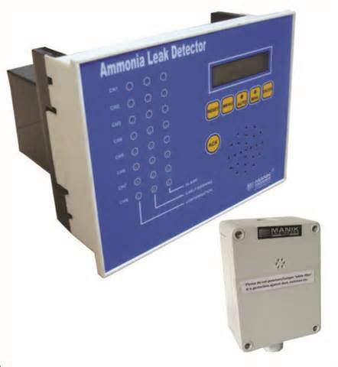
Potential Sources of RAGAGEP
Ammonia - IIAR
Bulletin 111 - Guidelines for: Ammonia Machinery Room Ventilation
Bulletin 112 - Guidelines for: Ammonia Machinery Room Design
Bulletin 114 - Guidelines for: Identification of Ammonia Refrigeration Piping and System Components
Bulletin 116 - Guidelines for: Avoiding Component Failure in Industrial Refrigeration Systems Caused by Abnormal Pressure or Shock
Notes:
Ammonia leak detectors are put in rooms where ammonia could be released through a leak.
36

Slide 37
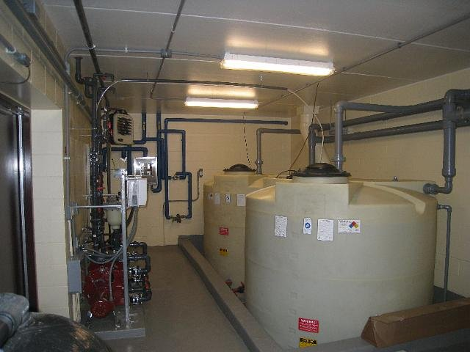
Potential Sources of RAGAGEP
The Chlorine Institute
Numerous Standards for:
Chlorine
Sodium hypochlorite
Hydrogen Chloride
Hydrochloric Acid
Many pamphlets available for free download
www.chlorineinstitute.org
Notes:
The Chlorine Institute has Numerous Standards for:
Chlorine
Sodium hypochlorite
Hydrogen Chloride
Hydrochloric Acid

Slide 38
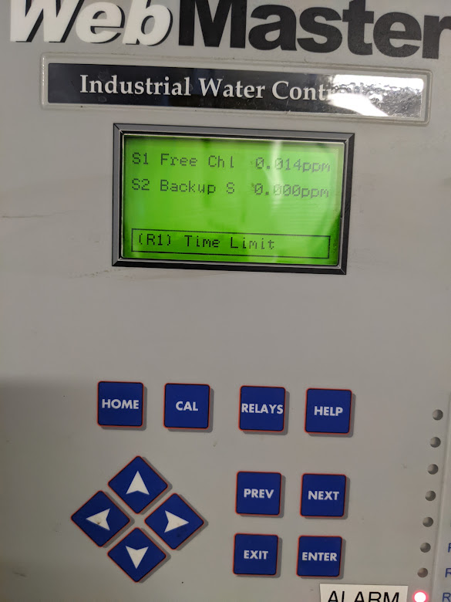
Chlorine
I hope the basement has the proper ventilation and if it does, install a green/red light at the entrance to the stairs.
Green we have glow/red no flow means no entry.
Over 1.0 ppm (STEL) requires APR;
5.0 ppm ppm (1/2 the IDLH) requires SAR.
No entry at 10 ppm (IDLH)

Slide 39
Knowledge check 14
The Process Safety Management (PSM) Standards require refresher training at least every______ years.
2
3
4
5

Slide 40
Knowledge check 14
The Process Safety Management (PSM) Standards require refresher training at least every______ years.
3

Slide 41
Notes:
There are many industry codes for various equipment. Today many equipment manufacturers have incorporated the codes into their manuals.

Slide 42
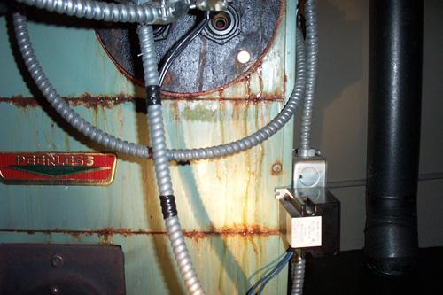
Potential Sources of RAGAGEP
API – American Petroleum Institute
ASME – American Society of Mechanical Engineers
NBIC – National Board Inspection Code, The National Board of Boiler and Pressure Vessel Inspectors
CCPS – American Institute of Chemical Engineers, Center for Chemical Process Safety
NFPA – National Fire Protection Association
Boiler leak
Notes:
OSHA can use these consensus standards and codes as a basis of a general duty clause citation or support for a PSM citation.
The Boiler and Pressure codes give guidelines for boiler maintenance.

Slide 43
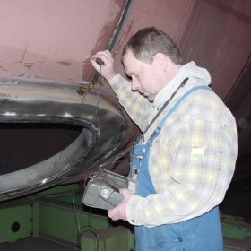
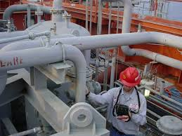
Potential Sources of RAGAGEP
ANSI – American National Standards Institute
NIOSH – National Institute for Occupational Safety and Health
ASNT – American Society for Non-Destructive Testing
ISA – International Society of Automation
ISA-TR84.00.04 – Safety Instrumented Systems
EPRI – Electric Power and Research Institute
Notes:
Worker is conducting thickness testing per the pressure vessel codes. Both photos.
43

Slide 44
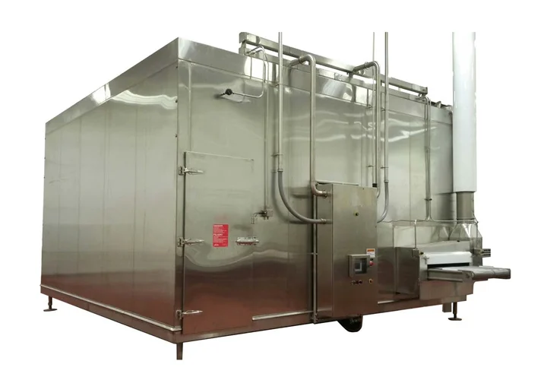
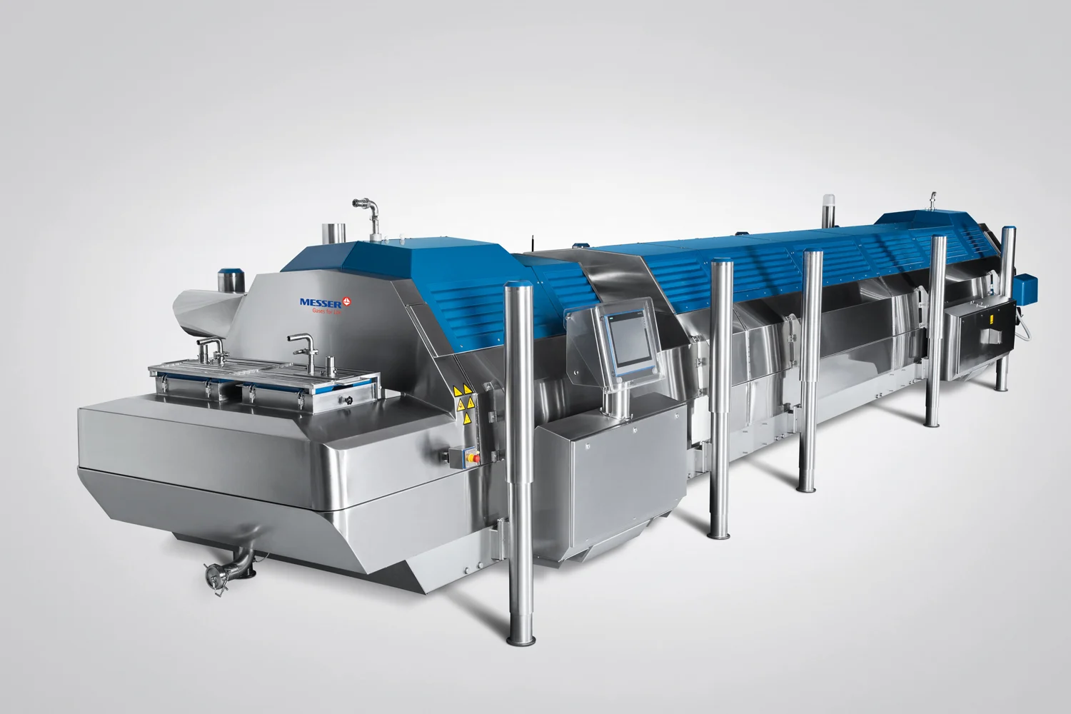
Nitrogen
Oxygen alarms
Ventilation
Signs for isolation valves
Procedures: startup, shutdown and emergency shutdown,
Respirator when uncertain air quality
Nitrogen vessel inspected and certified
Nitrogen offloading and fill connection are 10 feet from building exits.
Secure equipment from damage.
Cryogenic Food Freezing

Slide 45
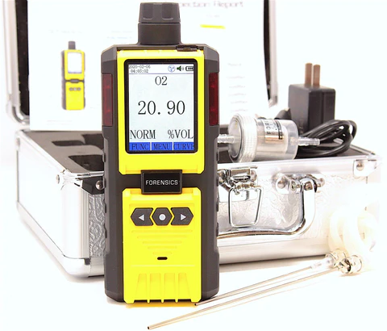
Nitrogen
The presence of nitrogen cylinders and containers requires a focus on safety.
Liquid Nitrogen rapidly vaporizes to gas at about 700 times the liquid volume.
By displacing air the gas may kill by asphyxiation.
When the oxygen concentration in air is sufficiently low, a person can become unconscious without any warning symptoms.
Fixed oxygen detector
Handheld oxygen detector
Notes:
https://www.rkiinstruments.com/blog/detector-heads/nitrogen-storage-monitoring/?utm_source=google&utm_medium=cpc&utm_campaign=RKI_DSA_Prospecting&utm_content=all%20web%20pages&utm_term=&gclid=Cj0KCQjw8O-VBhCpARIsACMvVLNiZD76uIW_HVMuY76-s2lst_A5oRrUniPDSoB_pqUbIybkzgwwDtUaAtMwEALw_wcB

Slide 46
Linebreaking
“Plant is down for a few days so doing a few bottom blowdown valve replacements.”
What issues?
Photo – Richard Clinton

Slide 47
Definitions
Flammable liquid means any liquid having a flashpoint at or below 199.4 °F (93 °C).
The lower flammable limit of a flammable gas or vapor is the:
Lowest concentration of the gas or vapor in air, expressed as a percentage, that can be ignited
NFPA 30 3.3.33.2* Flammable Liquid. Any liquid that has a closed cup flash point below 100°F (37.8°C)
Class IA Liquid — Any liquid that has a flash point below 73°F (22.8°C) and a boiling point below 100°F (37.8°C)
Notes:
This is test question 27
The lower flammable limit of a flammable gas or vapor is the:
Lowest concentration of the gas or vapor in air, expressed as a percentage, that can be ignited
Highest concentration of the gas or vapor in air, expressed as a percentage, that can be ignited
Amount, in grams or kilograms, that can be ignited
Amount that is equivalent to the limiting oxygen percentage that can be ignited
Ether would be category 1 or NFPA 1a

Slide 48
Flammable Liquid Storage
Flammable storage cabinet capacities:
25 gallons of Category I 120 gallons of Category 2, 3, 4
Notes:
1910.106(e)(2)(ii)(b)The quantity of liquid that may be located outside of an inside storage room or storage cabinet in a building or in any one fire area of a building shall not exceed:
1910.106(e)(2)(ii)(b)(1)25 gallons of Category 1 flammable liquids in containers
1910.106(e)(2)(ii)(b)(2)120 gallons of Category 2, 3, or 4 flammable liquids in containers
1910.106(e)(2)(ii)(b)(3)660 gallons of Category 2, 3, or 4 flammable liquids in a single portable tank.

Slide 49
Let’s count
Cabinet or no cabinet?
Notes:
If most are Category 2, then 120 gallons could be outside a cabinet.

Slide 50
Storage Room Capacity
Reference Table H-13 in 1910.106(d)(4)
Capacity is dependent on:
- room size
- fire resistant rating
- if fire protection is available
(gals/cubic feet/floor area)
Electrical lighting of this type and windows not allowed
Notes:
The room has no ventilation.
The electrical is not Class 1.
The windows means no

Slide 51
Knowledge Check 27
OSHA has incorporated by reference industry standard _________ for the handling, use, and storage of compressed gases.
CGA Pamphlet P-1
NFPA Publication 30

Slide 52
Knowledge Check 27
OSHA has incorporated by reference industry standard _________ for the handling, use, and storage of compressed gases.
CGA Pamphlet P-1
NFPA Publication 30

Slide 53
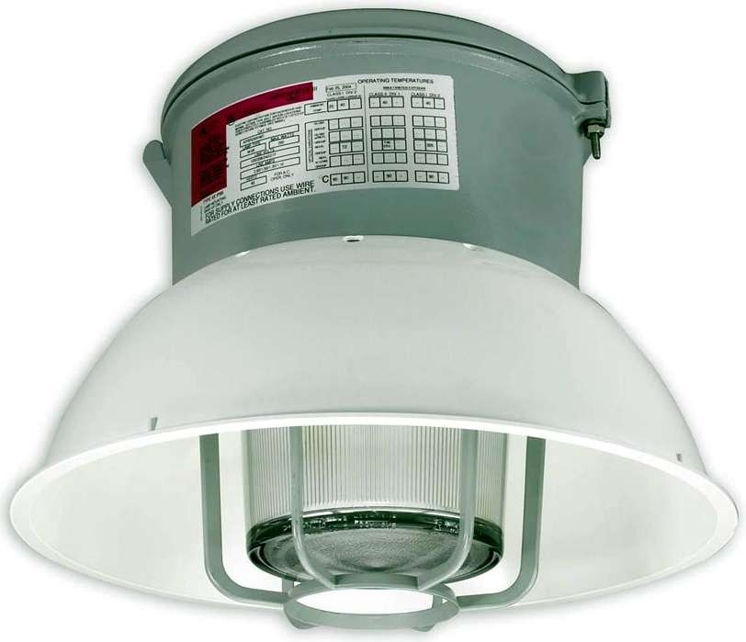
Electrical
Electrical installations (lighting, receptacles, etc) for Class I liquids must meet Class I, Division 2 Hazardous location requirements in Subpart S
Electrical for Class II and III is approved for general use
Notes:
Class I Locations
A “Class I Location” is created by the presence of flammable gases or vapors in the air in
sufficient quantities to be explosive or ignitable. When these materials are found in the
atmosphere, a potential for explosion exists if an electrical or other source of ignition is
present. Some typical Class I locations are:
• Petroleum refineries, and gasoline storage and dispensing areas;
• Dry cleaning plants where vapors from cleaning fluids can be present;
• Spray finishing areas;
• Aircraft hangars and fuel servicing areas; and
• Utility gas plants, and operations involving storage and handling of liquified petroleum
gas or natural gas.
Class II Locations
The second type of hazardous location is called a “Class II Location”. This classification is
created by the presence of combustible dust in the air in sufficient quantities to be explosive
or ignitable. Some typical Class II locations are:
• Grain elevators;
• Flour and feed mills;
• Plants that manufacture, use or store magnesium or aluminum powders;
• Producers of plastics, medicines and fireworks;
• Producers of starch or candies;

Slide 54
Ventilation
Gravity or mechanical
Six air changes/hour
Locate switch outside of room – wired with lighting
Notes:
Measure the length, width and height of your room in feet. Multiply these three figures together to get an approximate figure for the number of cubic feet in your room. For example, if the room is 10 feet by 10 feet by 12 feet, there are about 1200 cubic feet of air to move in the room.
Check your owner's manual to determine the capacity of the fan in cubic feet per minute.
Multiply the capacity of your fan in cubic feet per minute by 60 to convert it to cubic feet per hour. For example, if your fan were capable of 200 cubic feet per minute, you multiply it by 60 to get 12,000 cubic feet per hour.
Divide this figure by the volume of the room to calculate the number of air changes per hour. Finishing the example, divide 12,000 cubic feet per hour by 1,200 cubic feet to find that you get 10 air changes per hour.

Slide 55
LPG Storage
1910.110(f)(4)
Quantity of LP-Gas stored within buildings not frequented by the public, such as industrial buildings, must not exceed 300 pounds
Typical tank for forklift is 33 pounds. So nine inside.
Notes:
In buildings not frequented by the public (such as industrial facilities), not more than 300-pounds of LP gas in cylinders can be stored in one location. The quantity of LP gas stored in special buildings or rooms must not exceed 10,000-pounds.
NFPA 58

Slide 56
Propane Storage
NFPA 58
The storage of propane in buildings is limited:
Buildings frequented by the public are limited to cylinders with a propane capacity of 1 pound.
The total quantity stored is limited to 200 pounds of propane.
Buildings not frequented by the public are limited to a maximum quantity of 300 pounds of propane.
The cylinder size is not restricted.
Notes:
http://www.nfpa.org/Assets/files/AboutTheCodes/58/58_FAQs.pdf

Slide 57
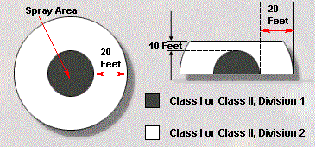
Open Spraying Locations
Notes:
NFPA 33 has guidelines on open spraying.

Slide 58
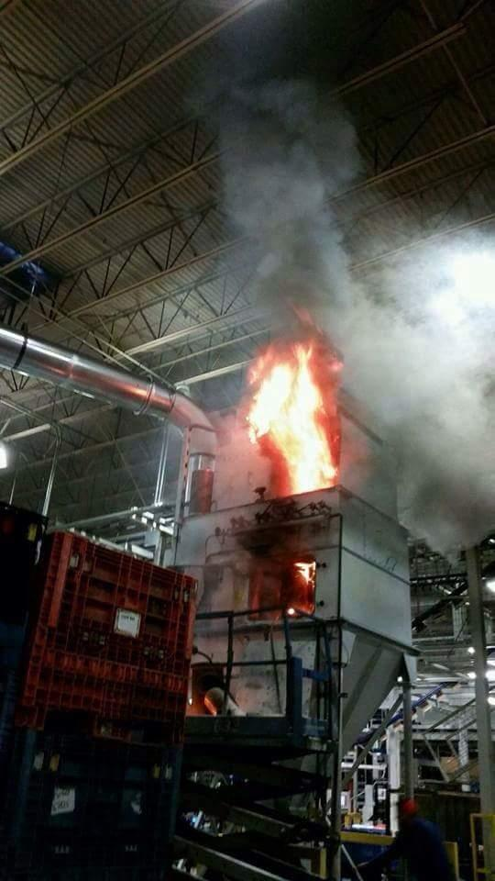
Combustible Dust Safety Optional
Notes:
A dust collector is on fire.

Slide 59
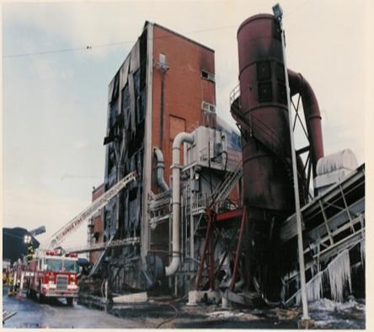
Coal Dust
Throughout a twenty‐five year (1980‐2005) study of PRB coal‐fired power plants, there were an average of 11 fires or explosions, 29 injuries, and 5 deaths per year.
Another study conducted by the United States Department of Labor during the 1996‐2009 time period noted 437 workplace coal power‐related deaths, averaging 33 deaths per year in the United States..
Will County Power Plant Crusher Building Explosion
Notes:
Sever
1924- Corn dust exploded in Pekin, Illinois, this caused 42 people to die.
1948- A Brach’s Candy factory in Chicago, Illinois exploded from a cloud of cornstarch, resulting in 18 deaths.
1975- A cloud of grain powder explodes at the Davenport river flour mill in Iowa. The explosion was powerful enough to shatter windows 20 blocks away, and killed 2 workers. This explosion led to changes in safety systems, including the use of confinement systems and no smoking policies.
1977- Explosion at a Galveston, Texas grain elevator was caused when low winter humidity made the grain dust dryer and more explosive than usual. 20 workers were killed in this accident.
1977- The worst flour mill explosion on record occurred in Westwego, Louisiana when a buildup of grain dust came in contact with static electricity. The explosion blew the top off the silo, and caused another 48 silos to catch fire. 36 workers were killed in this disaster, many from being crushed by the collapsing silos. Building code reforms for grain silos were based off this event.
1979- The Roland Mill in Bremen, Germany, was destroyed by a flour dust explosion, killing 14 and injuring 17.
1981- Custard dust that had accumulated in the factory ceiling and rafters blew down to create a dust cloud, which then exploded at a Bird’s Custard factory in Banbury, England. The explosion blew the roof off the building. As a humorous side note, custard is created when heat and water are added to the custard powder; the water from firefighters and the heat from the explosion caused gallons of custard to suddenly be created inside the building, which then came pouring out.
1998- A series of grain dust explosions began in a grain elevator before travelling throughout the grain storage facility in Haysville, Kansas. These explosions resulted in 7 people losing their lives.
1999- A natural gas boiler exploded at the Ford River Rouge Power Plant in Dearborn, Michigan, which caused a buildup of coal dust to create a secondary explosion, killing 6.
1999– Buildups of phenol formaldehyde resin had accumulated heavily in the ductwork and on high surfaces throughout the Jahn Foundry building in Springfield Massachusetts. The dust inside the ductwork ignited, causing an explosion to travel through the ducts to different areas of the factory, where high surface dust was shaken down and ignited. The explosion was able to lift the building’s roof and blow out its walls. 3 workers died later from burns they received during the explosion.
2002- Buildups of rubber dust at Rouse Polymerics in Vicksburg, Mississippi created an explosion that left 5 workers dead.
2003– Plastic dust explosion occurred at the West Pharmaceutical Services facility in Kinston, North Carolina after it had accumulated above tiles in a dropped ceiling. 6 workers were killed and dozens were injured when the building was completely destroyed.
2007- Combustible Dust NEP begins
al dust explosions have occurred over history.

Slide 60
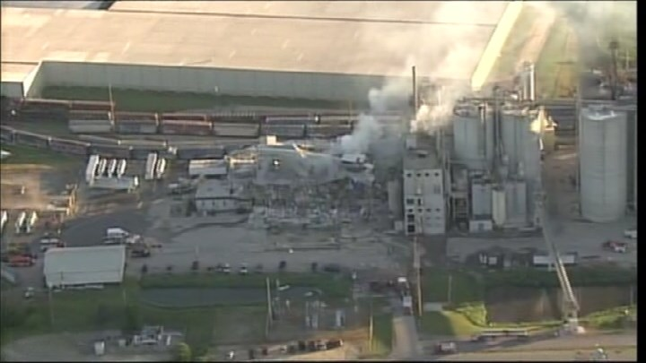
May 2017
On May 31 at approximately 11 p.m., an explosion occurred at our milling operations located in Cambria, Wisconsin.
The cause of the explosion is not known
Corn milling
5 dead
Notes:
At least one person was killed and more than a dozen were injured in an explosion and fire at Didion Milling in Cambria May 31, authorities reported. The sheriff in Columbia County said that the blast was reported around 11 p.m. Wednesday at the Didion Milling Plant in Cambria
https://madison.com/wsj/news/local/cambria-mill-that-exploded-had-been-reprimanded-on-safety-was-site-of-recent-fire/article_b3a87387-2616-5eb6-825f-a6147777f225.html#:~:text=At%20least%20one%20person%20was%20killed%20and%20more%20than%20a,Cambria%20May%2031%2C%20authorities%20reported.&text=The%20sheriff%20in%20Columbia%20County,Didion%20Milling%20Plant%20in%20Cambria.

Slide 61
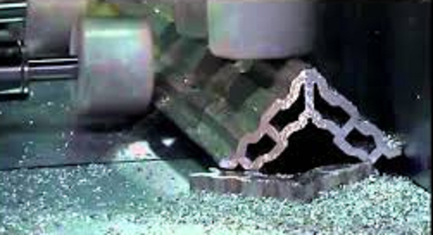
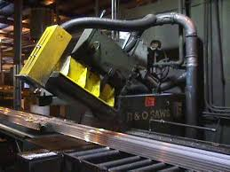
Apr 2017
Dust collection systems must be installed which will safely capture potentially explosive aluminum fines.
Metallic dusts from grinding, sawing or cutting should be picked up by one collection system, while dusts from buffing and polishing should be picked up by a different system.
This will prevent the mixing of explosive and flammable dusts.
Notes:
The NFPA 484 give guidance for metal dust and explosion prevention.

Slide 62
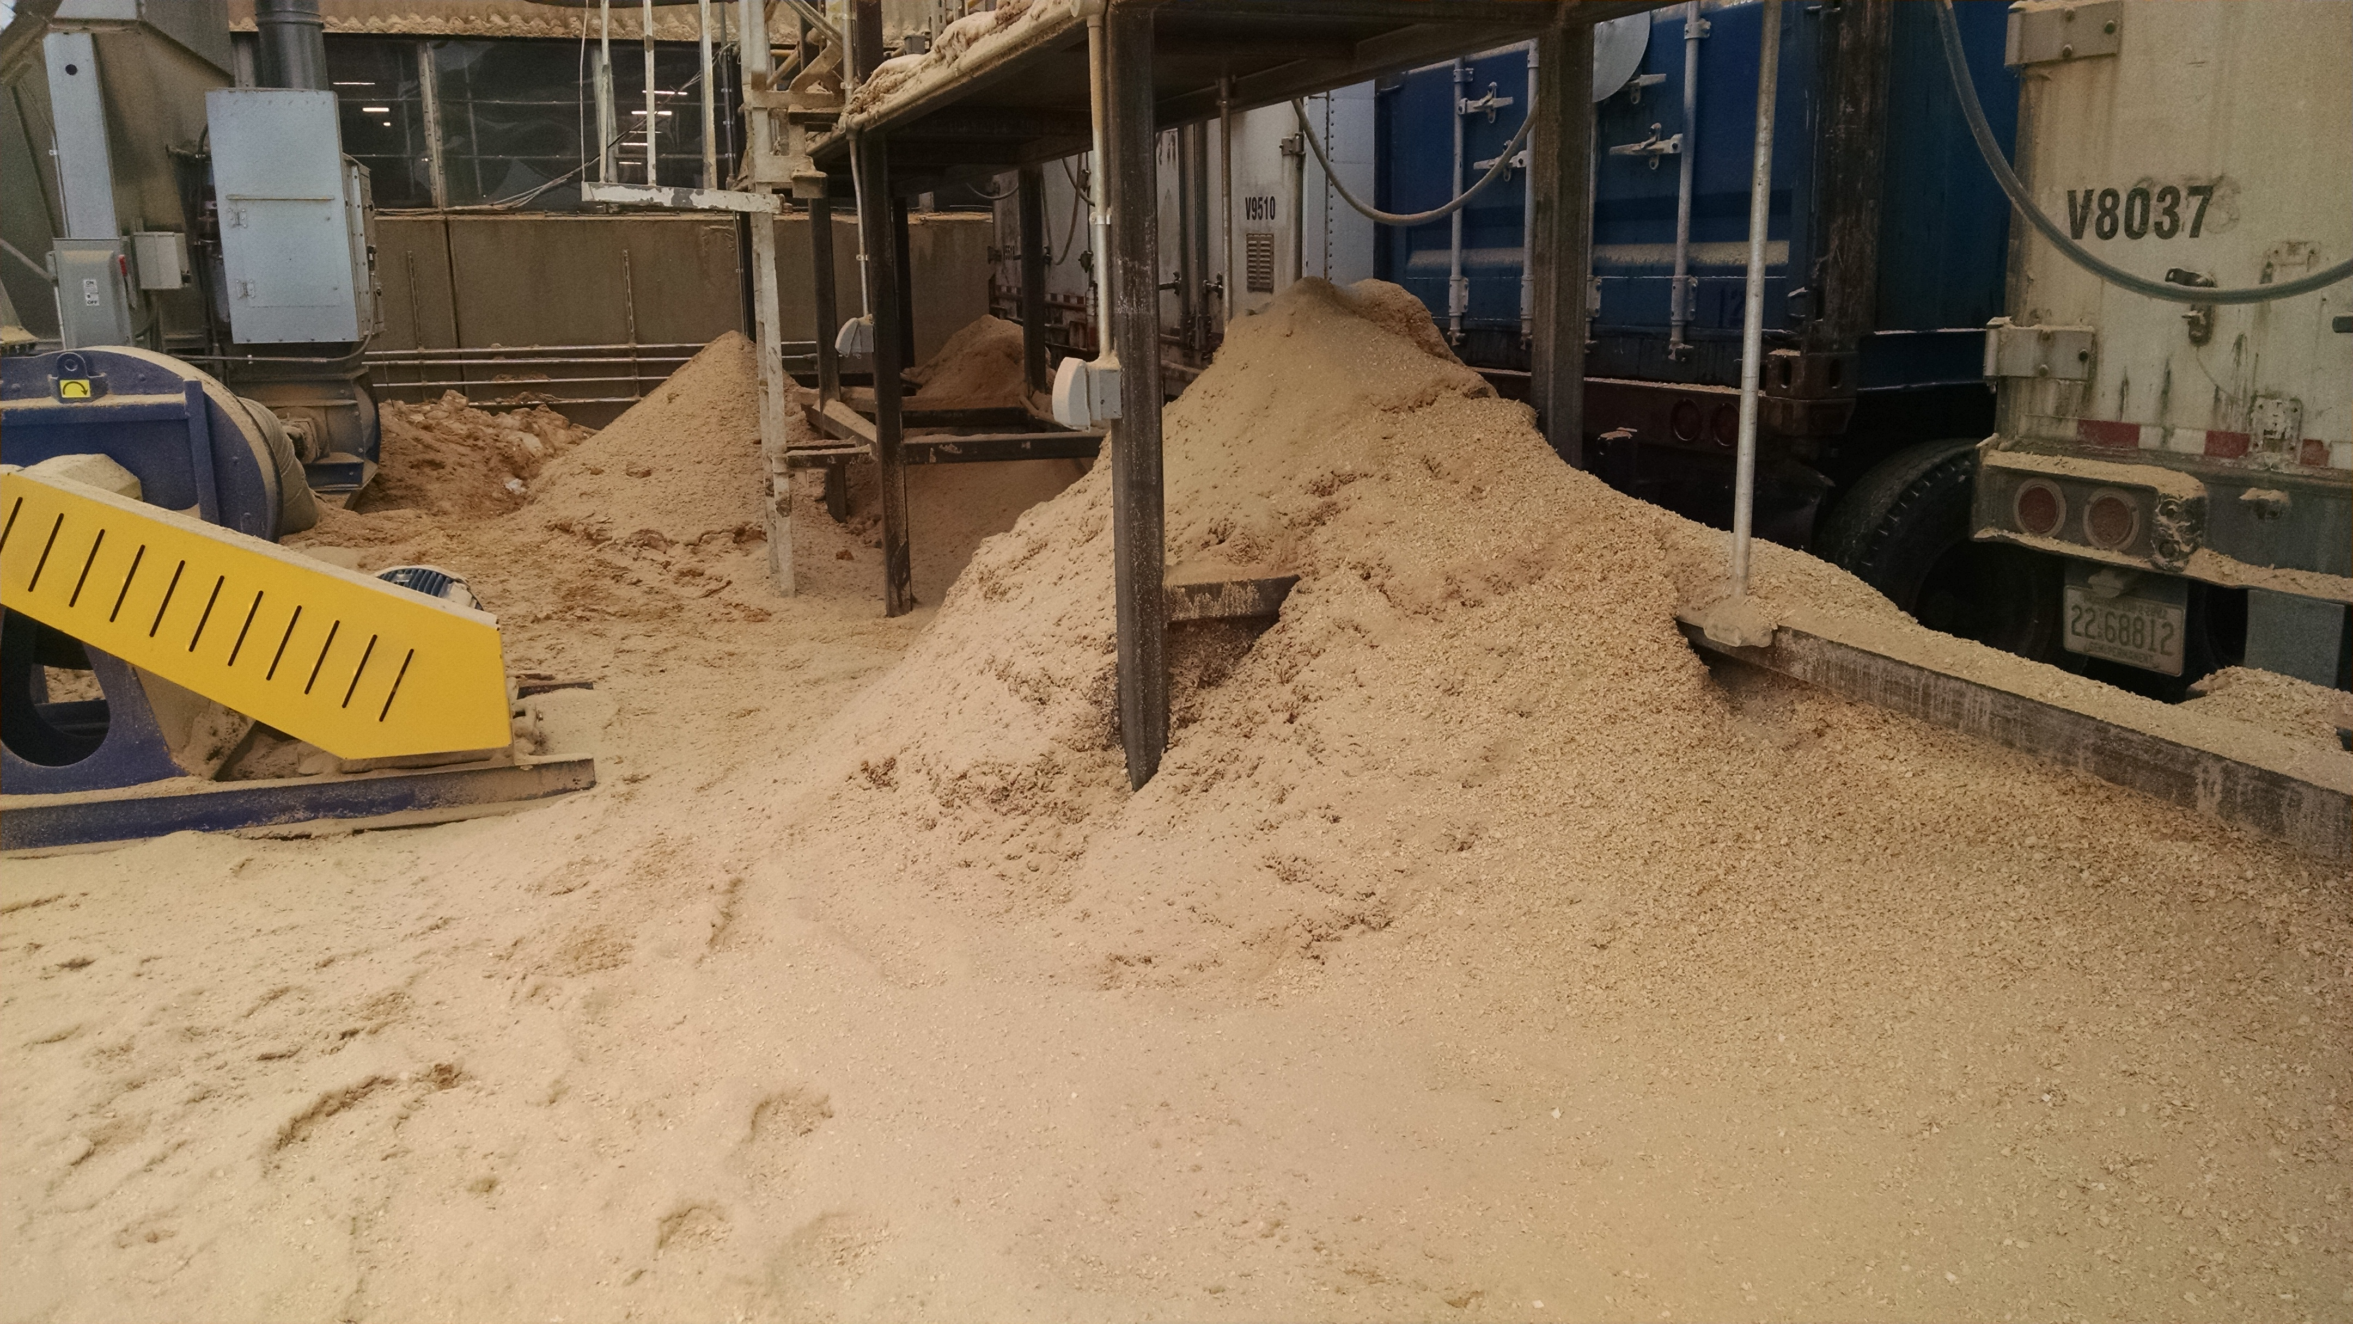
March 2017
Notes:
This is too much dust. It is a fire and a dust explosion hazard.

Slide 63
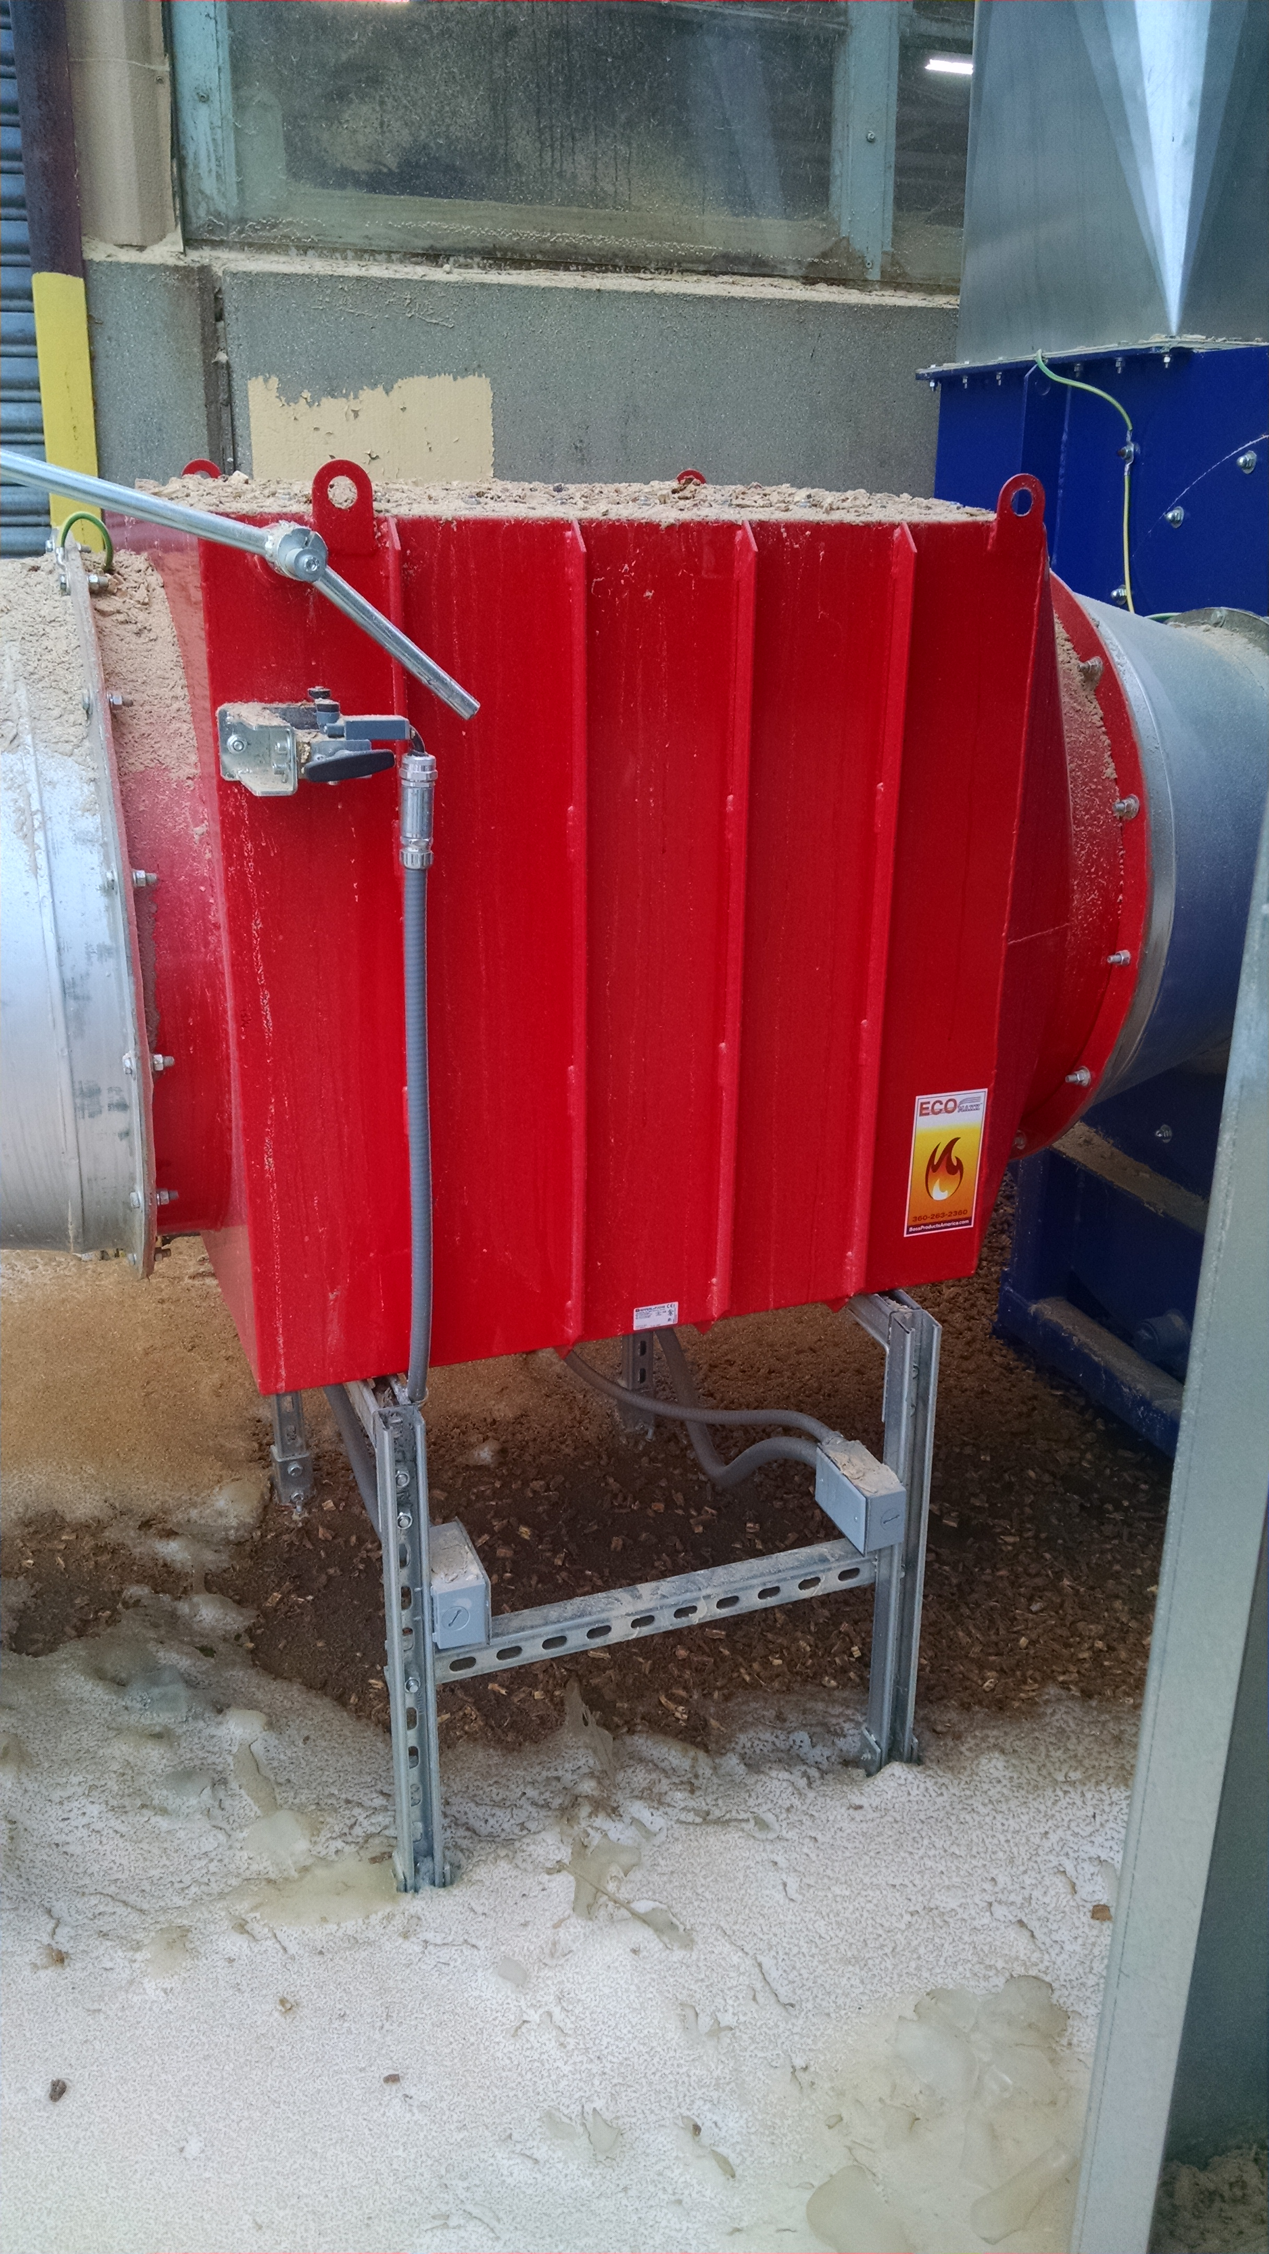
May 2017
NFPA requires that an explosion isolation device be installed on all suction side ducts that transport material with a KST value above zero.
KST values are used to measure the speed at which pressure rises during a standard explosion severity test.
EcoMAXX™ No Return Valve
Notes:
The installation of an explosion isolation device on all suction side ducting that transports combustible dust is an NFPA requirement. Installing a SAFETY SMART EcoMAXX® No Return Explosion Isolation Valve will protect workers and facilities from the damaging effect of a baghouse or filter explosion.

Slide 64
Imperial Sugar - 2008
Feb 7, 2008
14 died
60 injured
$180-220 million dollar est. loss
$7,700,000 Fine – OSHA
Notes:
On February 7, 2008, a huge explosion and fire occurred at the Imperial Sugar refinery northwest of Savannah, Georgia, causing 14 deaths and injuring 38 others, including 14 with serious and life-threatening burns. The explosion was fueled by massive accumulations of combustible sugar dust throughout the packaging building.
https://www.csb.gov/imperial-sugar-company-dust-explosion-and-fire/

Slide 65
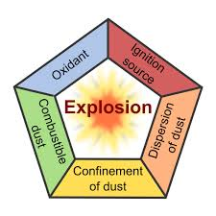
Notes:
For any fire to occur, there must be fuel, ignition and oxygen (Classic Fire Triangle). However, for a combustible dust explosion, you must also add dispersion and confinement — the “Dust Explosion Pentagon.” Removal of any one element prevents an explosion, though not necessarily a fire.

Slide 66
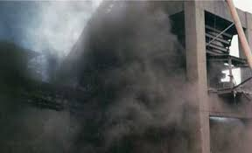
Chemical Safety Board
From 2008 to 2012, our board documented, 50 combustible dust accidents that led to 29 fatalities and 161 injuries.
Notes:
https://ohsonline.com/Articles/2018/09/01/Combustible-Dust-Explosions.aspx
In a 2014 New York Times article,¹ the chairman of the U.S. Chemical Safety Board (CSB) stated that, "From 2008 to 2012, our board documented 50 combustible dust accidents [that] led to 29 fatalities and 161 injuries." This documentation was published in the aftermath of a horrific metal dust explosion in Jiangsu Province, China, that killed 75 people and injured another 185. It also followed an earlier 2006 CSB report that cited "281 combustible dust incidents between 1980 and 2005 that killed 119 workers, injured 718, and extensively damaged industrial facilities." Figure 1 shows global dust explosion statistics and specifically for the United States and China over an 80-year period; it is interesting that the same report² shows that the issue in China is consistent with increased industrial output

Slide 67
Typical 5(a)(1) Violations
Systems were not provided to prevent deflagration propagation from dust collectors to other parts of the plant.
October 29, 2003 - Hayes Lemmerz Manufacturing Plant, IN
Shawn Boone, 33, died in the Aluminum Dust explosion
Notes:
Section 5(a)(1) of the Occupational Safety and Health Act of 1970: The employer did not furnish employment and a place of employment which were free from recognized hazards that were causing or likely to cause death or serious physical harm to employees in that employees were exposed to an explosion hazard from inadequate deflagration venting and lack of backflash dampers between milling and collection systams: (a)Milling Area The deflagration vents on all the Newman & Esser dust collection systems, model number CAR60 252/170, used to collect powder coating dust, were not vented to the outside of the building, on or about September 24, 2008. (b)Milling Area The ventilation duct from all the milling machines to the NEA Group dust collection systems did not have backflash dampers to prevent an explosion from traveling back to the work area, on or about September 24, 2008. (c)Outside Area The Dustex 2000 dust collection system located outside, modnumber CJUP 5000, did not have a backflash damper to prevent an explosion from traveling back to the work area, on or about September 24, 2008. ABATEMENT NOTE: Among other methods, one feasible and acceptable abatement method to correct the hazard is to comply with the National Fire Protection Association (NFPA 654), "Standard to Prevention of Fire and Dust Explosions for the Manufacturing, Processing and Handling of Combustible Particulate Solids"-2006 as it applies to your operations and equipment including but not limited to: (a)Install vent ducts for the dust collection system to the outside of the building in accordance to NFPA 68, Venting of Deflagrations. (b)Install an isolation device to prevent deflagration propagation from air material separators upstream to the work areas. VERIFICATION REQUIRED

Slide 68
Typical 5(a)(1) Violations
No explosion relief venting distributed over the exterior walls and roofs of the buildings.
CTA Acoustics 2003 – 7 dead
Fiberglass fibers and excess phenolic resin powder probably went to the oven while workers were using compressed air and lance to break up a cogged bag house filter
Notes:
02/20/2003
Corbin , KY
7 fatalities, 37 injured
4 serious including 1910.307b, 28k
Fiberglass fibers and excess phenolic resin powder probably went to the oven while workers were using compressed air and lance to break up a cogged bag house filter.

Slide 69
Typical 5(a)(1) Violations
Dust Collector and ducts do not prevent propagation to other parts of the plant
From BS&B
Notes:
Deflagration isolation systems were not provided to prevent deflagration propagation from dust collectors to other parts of the plant.

Slide 70
Typical 5(a)(1) Violations
Ducts and system were not grounded
Notes:
Section 5(a)(1) of the Occupational Safety and Health Act of 1970: The employer did not furnish employment and a place of employment which were free from recognized hazards that were causing or likely to cause death or serious physical harm to employees in that employees were exposed to severe burns from the potential dust explosion, deflagration and fire hazards caused by the improper design, and maintenance of dust collection system. a.A section of duct located over the ship lap machine was covered with combustible duct tape material. b.A duct end in use was covered with a wood cap held in place with combustible duct tape. c.The ducts did not have deflagration venting, fire protection or explosion suppression systems. d.The fans and blowers were located on the dirty side of the dust collecting systee.The dust collection systems in both the old and new buildings were never balanced. f.None of the ducts were grounded. g.None of the dust collectors had deflagration venting. ABATEMENT NOTE-Among other methods, one feasible and acceptable abatement method to correct these hazards is to have a qualified engineer inspect the dust collection system to ensure that it is designed and installed in accordance with National Fire Protection Association (NFPA) 664-2007, Standard for the Prevention of Fires and Explosions in Wood Processing and Woodworking Facilities. Abatement measures include: *Repair the gap in the section of duct with non-combustible material; *Design, construct, and install ducts with metal sufficient to withstand the maximum unvented deflagration pressure, explosion suppression systems, or deflagratirelief venting; *Relocate the fan to the clean side of the dust collector; *Balance and re-balance, as necessary, the dust collection system; *Bond and ground the dust collection system ductwork with such methods as listed in NFPA 664-2007, paragraph 7.6.2;

Slide 71
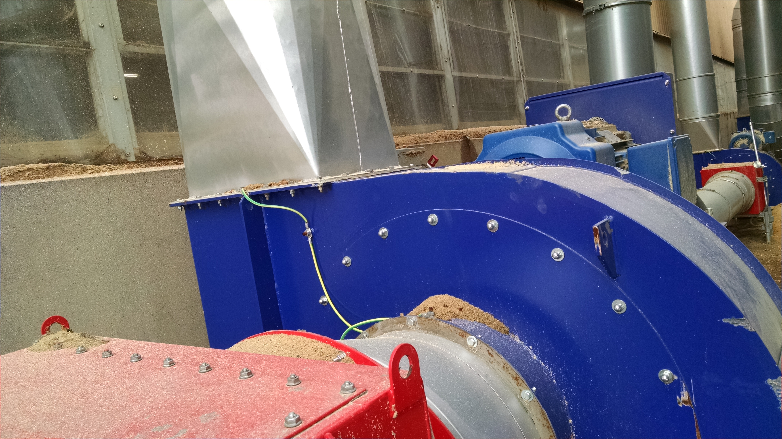
Grounding
All equipment used in the dust generating process must be thoroughly grounded to remove static electricity.
“Recommended Practice on Static Electricity,” NFPA 77, should be followed.
Inspection and cleaning of all electrical equipment must be done regularly and frequently (at least weekly).
Ground connections should be checked visually on a daily basis by the operators.
Notes:
DUST COLLECTION AND DISPOSAL Either dry-type or wet-type dust collectors may be used and the following recommendations apply to both. The hoods, enclosures, duct work and collectors should be constructed of rustproof and non-sparking metal. To ensure the ductwork is as short as possible, each dust producing machine area should have a separate pick up hood or enclosure connected to its own dust collector located outside the building. Dust collection systems handling aluminum or aluminum alloy dusts should be dedicated for that use only. If the collection system is to be used for the collection of dusts of other metals, the system should be disassembled and thoroughly cleaned prior to and after use for dusts of other metals. Metallic dusts from grinding, sawing or cutting should be picked up by one collection system, while dusts from buffing and polishing should be picked up by a different system. This will prevent the mixing of explosive and flammable dusts. To prevent a build up of static electrical charges, the entire system should be thoroughly grounded, including the machine generating the dust, the conveying ductwork and the collector. Detailed guidelines are given in National Fire Protection Association Standard No. 77, “Recommended Practice on Static Electricity.” It is important that both the coarser and finer particles be moved efficiently to the dust collector and therefore a minimum velocity of 4500 f.p.m. should be maintained in the conveying ductwork. The concentration of aluminum fines in the air in the ductwork should be safety below the lower explosive limit. This is reported by the former U.S. Bureau of Mines to be 0.040 oz. per cu. ft. (Report of Investigation RI-6516, Explosibility of Metal Powders). The environmental aspects of plant disposal are beyond the scope of this brochure. However, aluminum fines may be recycled through companies that process aluminum scrap and/or aluminum dross. Contact The Aluminum Association for names and addresses of these firms.
https://www.aluminum.org/sites/default/files/Safe%20Handling%20of%20Aluminum%20Fine%20Particles.pdf

Slide 72
Typical 5(a)(1) Violations
Airborne fugitive dust
Notes:
Section 5(a)(1) of the Occupational Safety and Health Act of 1970: The employer did not furnish employment and a place of employment which were free from recognized hazards that were causing or likely to cause death or serious physical harm to employees in that employees were exposed to the hazards of fire and explosion due to the unsafe methods of collecting aluminum dust. Acme Alliance LLC did not ensure that where aluminum and aluminum alloys are subjected to processing or finishing operations, the material discharged from dry-type collectors is discharged into metal containers that are promptly and tightly covered to avoid the creation of airborne fugitive dust at each of the following dust collectors: a) Green Value Stream Blast-It-All M2 dust collector, Serial Number 050714206 (installed in July, 2005). Metal dust containing aluminum collected from the 5 gallon plastic discharge pail was analyzed for explosibility and found to be a Class ST1 explosive material. b) Blue Value Stream George Fischer Goff Model 1850 dust collector used with Goff shot blaster, Serial Number 94051-50-4446 (installed in early 2000). Settled metal dust containing aluminum collected from the outside surfaces of this machine was tested and found to be a Class ST1 explosive material. The dust was collected into a metal container which was not kept covered at the base of the equipment. c) White Value Stream Blast-It-All M4 dust collector, Serial Number N031125501SG (installed in November, 2003). Metal dust containing aluminum collected from the 5 discharge pail was analyzed for explosibility and found to be a Class ST1 explosive material. General methods of abatement, among others is to discharge material from dry-type collectors into metal containers that are promptly and tightly covered as prescribed by National Fire Protection Association (NFPA) 484, Standard for Combustible Metals, 2006, relating to minimization of the occurrence of and resulting damage from fire and explosion in areas where combustible metal dusts are produced. Section 6.3.5.5.2: "The material shall be discharged into metal containers that shall be promptly and tightly covered to avoid the creation of airborne fugitive dust." In accordance with 29 CFR 1903.19(d), abatement certification is required for this violation (using the CERTIFICATION OF CORRECTIVE ACTION WORKSHEET), and in addition, documentation demonstrating that abatement is complete must be included with your certification. This documentation may include, but is not limited to, evidence of the purchase or repair of the equipment, photographic or video evidence of abatement, or other written records.

Slide 73
Typical 5(a)(1) Violations
A means of tramp metal protection was not provided to keep any unwanted metal fragments out of the air-material separators
From Duramag
Notes:
Section 5(a)(1) of the Occupational Safety and Health Act of 1970: The employer did not furnish employment and a place of employment which were free from recognized hazards that were causing or likely to cause death or serious physical harm to employees in that employees were exposed to serious burns from potential dust deflagration, explosion, or other fire hazards as the result of the improper design and maintenance of dust collection systems: (a)SourceCut Industries, Inc. in Osseo, WI: The following deficiencies were found with the Torit #'s 3,4,and 5 combination cyclone and enclosureless dust collection systems for hardwoods and medium density fiberboard: (1)A means of tramp metal protection was not provided to keep any unwanted metal fragments out of the air-material separators. (2)A means of static charge dissipation, such as bonding or grounding, was not provided for the process of removing the dust collection drums beneath the cyclo(3)A means of static charge dissipation, such as bonding or grounding, was not provided between the air material separators and the pieces of equipment which were connected by flexible non-metallic duct work. (4)Use of flexible non-metallic duct work exceeded the minimum required for machinery operation. (5)Systems were located indoors without a spark detection system with high speed abort gate or extinguishment and without a deflagration control system. (6)Systems were located within 20 feet of each other, operator positions, and exit routes. (b)SourceCut Industries, Inc. in Osseo, WI: The following deficiencies were found with the main Torit bag house dust collector and the main facility dust collection system used for wood dusts: (1)A means of tramp metal protection was not provided to keep anyunwanted metal fragments out of the air-material separator or the hammermill associated with the dust/scrap wood conveying process. (2)A means of static charge dissipation, such as bonding or grounding, was not provided between the air-material separator and pieces of equipment which were connected by flexible non-metallic duct work. (3)Use of flexible non-metallic duct work exceeding the minimum required for machinery operation on equipment, such as but not limited to, the W3 OPTI (Paul), W2 MULTIRIP (Johnson), HOUNCHER (US Concepts),W8 SANDER PLANER (Lemco), and W52 ABRASIVE PLANER (Timesaver). (4)A deflagration venting panel on the air-material separator was oriented directly toward the SW corner of the facility. (5)A spark detection system with a high-speed abort gate or extinguishment was not installed downstream of the last material entry point and upstream of the air-material separator where machinery having a history of producing frequent sparks, including CNC routers, large belt sanders and planers having automatic feed systems, and hammermills were used. (6)A deflagration isolation or suppression system was not provided between the hammermill associated with the dust/scrap wood conveying process and main dust collection system duct work. (7)A deflagration isolation or suppression system was not provided for the inlet (dirty air) side of the air-material separator. (8)Addition of equipment, duct work size reduction modifications, and dynamic changes via the frequent use of dampers were made to the system without ensuring that the other remaining portions had sufficient capture and air conveying velocities. (9)The capacity of the system was calculated by the employer on the basis of all hoods and other openings connected to the system being open and showed the fan to be undersized by approximately 10,800 CFM. (10)Multiple dampers, gates, and cardboard orifice plates provided for the purpose of attempting to balance airflow in the system were not fastened in place to prevent inadvertent movement. (11)A documented housekeeping program was not developed. (12)Dust collection capture was not sufficient to capture wood dust for W4 CNC ROUTER (Northwood) and W46 CNC ROUTER (Shoda).(13)A 'blow down' safety program was not implemented where employees were allowed to use compressed air to clean off equipment and floor surfaces. AMONG OTHER METHODS, ONE FEASIBLE AND ACCEPTABLE MEANS OF ABATEMENT WOULD BE TO COMPLY WITH THE GUIDELINES OUTLINED IN NATIONAL FIRE PROTECTION ASSOCIATION (NFPA) 664 "STANDARD FOR THE PREVENTION OF FIRES AND EXPLOSIONS INWOOD PROCESSING AND WOODWORKING FACILITIES (2007) EDITION". Abatement certification and documentation are required for this item.

Slide 74
Typical 5(a)(1) Violations
Excessive dust
Not cleaning per the appropriate NFPA Standard
Notes:
North Carolina General Statute 95-129(1) of the Occupational Safety and Health Act of North Carolina: The employer did not furnish each of his employees conditions of employment and a place of employment free from recognized hazards that were causing or likely to cause death or serious physical harm to employees in that employees were exposed to the hazard of potential fire and explosion because methods were not utilized to contain combustible wood dusts created by manufacturing, handling, and processing operations from becoming airborne and combining with an ignition source: a)facility where combustible dust had accumulated on surfaces of machinery, floors and high places such as ceiling joists, structural members, to a measured depth of greater than 1/32 inch. Abatement Note: One feasible and acceptable abatement method among others, to correct this hazard is to establish regular cleaning frequencies for walls, floors, and horizontal surfaces, such as equipment, ducts, pipes, hoods, ledges, beams, and other concealed surfaces, to minimize dust accumulation within operating areas of the facility. Reference: National Fire Protection Agency (NFPA) 664 Standard for the Prevention of Fires and Explosions in Wood Processing and Woodworking Facilities (2007), paragraph 8.2.1.2.h

Slide 75
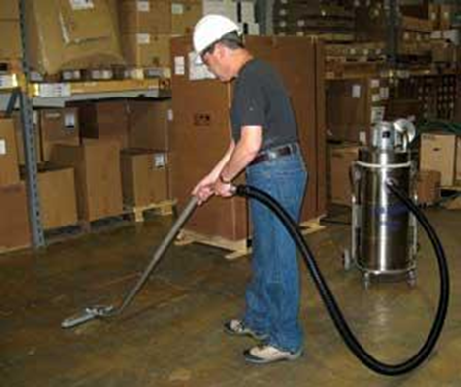
Typical 5(a)(1) Violations
Compressed Air was used for cleaning
Tip: Clean fugitive dust
Regular program
Access to hidden areas
Safe cleaning methods
Maintain dust free as possible
No blow down unless All electrical power and processes have been shutdown and other means cannot work.
See NFPA
Notes:
North Carolina General Statute 95-129(1) of the Occupational Safety and Health Act of North Carolina: The employer did not furnish each of his employees conditions of employment and a place of employment free from recognized hazards that were causing or likely to cause death or serious physical harm to employees in that employees were exposed to the hazard of potential fire and explosion because methods were not utilized to contain combustible wood dusts created by manufacturing, handling, and processing operations from becoming airborne and combining with an ignition source: a)facility, production where the employer did not ensure the minimization of dust clouds by allowing employees to use compressed air rated at 105 p.s.i. to clean flat surfaces and equipment. ABATEMENT NOTE: The use of compressed air shall be permitted only where the following requirements are met: 1)Area and equipment shall be vacuumed prior to blow down. 2)Electrical equipment not suitable for Class II locations and other sources of ignition shall be shut down or removed from the area. 3)Only low-pressure steam or compressed air, not exceeding a gauge pressure of 15 p.s.i. shall be used. 4)No hot surfaces or flames capable of igniting a dust cloud or layer shall exist in the area. Reference: National Fire Protection Agency (NFPA) 664 Standard for the Prevention of Fires and Explosions in Wood Processing and Woodworking Facilities (2007), paragraph 8.2.2.2.h

Slide 76
Typical 5(a)(1) Violations
No PVC or nonconductive ducts
Notes:
5(a)(1) of the Occupational Safety and Health Act of 1970: "The employer did not furnish employment and a place of employment which were free from recognized hazards that were causing or likely to cause death or serious physical harm in that the employees were exposed to fire hazards. Beet Pulp Pelletizing Area: a) On or about October 12, 2008, and at times prior thereto, the company was drawing dust through a dust collection system where some component materials of construction of that intake duct work was PVC piping, a combustible material. b) On or about October 12, 2008, and at times prior thereto, the company was conveying dust through conductive duct work (PVC) in the dust collection system.

Slide 77
Typical 5(a)(1) Violations
Not maintaining duct velocity
Aluminum Conveyor velocity might be 4500 ft/min for pneumatic conveyors
Notes:
Section 5(a)(1) of the Occupational Safety and Health Act of 1970: The employer did not furnish employment and a place of employment which were free from recognized hazards that were causing or likely to cause death or serious physical harm to employees: Commercial Alloys Corporation 1831 East Highland Road, Twinsburg, OH: Dust containing aluminum collected near the large shredder on August 20, 2008, was a Class St1 explosive dust, indicating the potential for explosion if ignited. The following conditions found at the facility increase the potential for an explosion and/or severity of an explosion: a.The large shredding machine produces fine particles of aluminum dust; however the ductwork for the dust collection system did not maintain a velocity of at least 1364 m/min (4500 ft/min) to ensure the transport of both coarse and fine particles and to ensure re-entrainment. b.A time delay or equivalent device was not provided on the large shredding machine to present thestarting of its motor drive until the dust collector is in complete operation. c.Super sacks were used to collect fines discharged from the dust collector. d.Fire extinguishers rated for Class ABC fires were mounted in an area where dry combustible aluminum dust was present. e.Brooms used for cleaning had synthetic fibers. f.Shovels used for collecting sweepings were made of plastic and steel. g.There were no procedures established for handling clothing fires. Among other methods, one feasible and acceptable abatement method to correct this hazard is to conduct a process hazard analysis by an individual knowledgeable about explosive metal dusts and comply with applicable standards issued by the National Fire Protection Association (NFPA) 484 Standard for Combustible Metals, Chapter 6, "Aluminum" and Chapter 13, "Fire Prevention, Fire Protectioand Emergency Response," and to follow-up on any provided recommendations.

Slide 78
How Much Dust is too Much?
Notes:
However, in accordance with the National Fire Protection Association, OSHA developed its Combustible Dust National Emphasis Program, which recommends not letting dust accumulate to more than 1/32 of an inch (about the thickness of a dime or paper clip) over more than five percent of a work area.
These observations help to explain the advice given by experienced industrial practitioners on the matter of acceptable combustible dust layer thicknesses. Their comments, although anecdotal, have a firm foundation in the physics and chemistry of dust explosions. Scientific underpinning by the aforementioned difficulties in physically dispersing and chemically reacting excessively thick dust deposits is intrinsic to the following expressions:
There's too much layered dust if you can see your initials written in the dust.
There's too much layered dust if you can see your footprints in the dust (Anonymous, 1996. Personal communication, with permission).
There's too much dust if you can’t tell the color of the surface beneath the layer (Freeman, R., 2010. Personal communication, with permission).
I tell my plant manager to write their name on their business card. It's time to clean up when they can’t read their name because of layered dust. (Anonymous, 2012. Personal communication, with permission).
https://ohsonline.com/Articles/2014/05/01/Combustible-Dust-Basics.aspx

Slide 79
NFPA References
654 General
664 Wood
61 Agriculture
484 Metal
850 Coal Power Plants
70 National Electric Code
499 Classification of Combustible Dust
68 Deflagration Venting Systems
69 Explosion Prevention Systems
91 Exhaust Systems
2113 Flame Resistant Clothing
Notes:
CSB advocated specifically for NFPA 654 & 484
General Duty Clause

