Slide 1
Homicide Prevention
Security and Violence Prevention
BLS
Active Shooter
Office Design
BLS
Have a Plan
Notes:
Event of 9/11 have focused heavily on preventing the possibility of another terrorist event
Several other examples
Oklahoma/Atlanta bombings
Anthrax scare

Slide 2
Statistics
According to the BLS DOJ report, workplace homicides peaked at 1,080 in 1994, then declined 58% over a 25-year period to 454 in 2019.

Slide 3
Statistics
Female workers had higher rates of nonfatal injuries (5.1 per 10,000) than male workers (2.3 per 10,000) due to workplace violence resulting in days away from work, according to data from the BLS
Police officer homicides were 116 in 2021.

Slide 4
Knowledge Check
31. Any organization or workplace can encounter emergencies originating from a myriad of sources at any given time.
Which is the MOST effective safety management instrument for reducing incidents at a workplace?
Perform pre-employment screening for potential hires.
Implement a detailed written management plan.
Establish strong ties with emergency response teams.
Invest in premium safety equipment.

Slide 5
Knowledge Check
31. Any organization or workplace can encounter emergencies originating from a myriad of sources at any given time.
Which is the MOST effective safety management instrument for reducing incidents at a workplace?
Perform pre-employment screening for potential hires.
Implement a detailed written management plan.
Establish strong ties with emergency response teams.
Invest in premium safety equipment.

Slide 6
Active Shooter
Feb 14, 2008
5 died
NIU police at area within 2 minutes.
Phones not work.
Some text messages got through.

Slide 7
Alcohol
West Orange bouncer killed at work remembered as loving father of four
Trying to stop a fight at 2am

Slide 8
Security

Slide 9
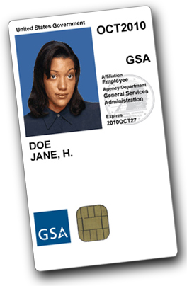
Front Office
Install security cameras outside all entrances and in stairwells if you can afford it.
Stairwell doors should lock from the outside, allowing only employees with keys to enter your space from stairwells.
Strong doors and windows, including tempered or bulletproof glass.
Limit who can sign for or accept packages.
Improve lighting.
Employee policies.
Training.
Meet with experts.
Review access.
Provide badges.
Buzzer system.
Place your reception desk in a place that allows your receptionist to see who is approaching your desk as early as possible.
Consider requiring visitor ID badges and sign-in.

Slide 10
External Risk Factors Include:
Working alone or in small numbers.
Working late night/early morning.
Working with money.
Delivering passengers, goods or services.
Having a mobile workplace like a taxicab or police car.
Working in high crime areas.
Guarding property or possessions.
Contact with the public (Alcohol)

Slide 11
Internal Risk Factors Include:
Highly competitive sectors with intense workloads, e.g. food processing.
Restructuring of an organization, e.g. impending layoffs.
Ignoring warning signs from certain individuals who have a gripe with co-workers or management.
Allowing an ongoing feud between co-workers to go unaddressed by management.
Chronic verbal abuse by a supervisor towards workers.
Denial on the part of management regarding employee tension or favoritism towards one party.
Old school mentality by management that tolerates and enables supervisor abuse.

Slide 12
How Can Violence Be Prevented on the Job?

Slide 13
Prevention Strategies (External Risk)
Don’t work alone late at night or early morning.
Call for a security escort if working late.
Carry a cellular phone.
Redesign workspace to prevent entrapment.
Train staff in ways to diffuse violence.
Place curved mirrors at hallway intersections.
Maintain good lighting indoors and outdoors.
Prepare plan for consumers who “act out”.
Control access to employee work areas.

Slide 14
Knowledge Check
32. What is a factor implicated in one-third of all incidents related to violence in the workplace?
The offenders are aged 60 or above.
The offenders have a previous criminal record.
The offenders are under the influence of narcotics.
The offenders are under the influence of alcohol.

Slide 15
Prevention Strategies (Internal Risk)
Risk Assessment: Confidential survey of all employees designed to uncover internal risk factors, coupled with analysis of external risk factors.
Presentation of overall risk analysis to top management, along with supporting facts.
WPV training for all levels of organization.
Sensitivity training for high-risk employees as necessary.
Follow-up survey of employees to gauge impact of training.

Slide 16
Responding to a Violent Incident
Isolate/secure the work area.
Call 9-1-1 if it is an emergency.
Seek medical attention for victims.
Report the incident to your supervisor.
Report the incident to your shop steward.
File an incident report.
If psychological trauma occurs call EAP for post-incident debriefing.
Give a referral to EAP to the victim.

Slide 17
Knowledge Check
Which workers are MOST at risk from violence at work?
Drivers
Clerks
Police officers
Doctors

Slide 18
Knowledge Check
Which workers are MOST at risk from violence at work?
Drivers
Clerks
Police officers
Doctors

Slide 19
Five Warning Signs of Escalating Behavior
Confusion
Frustration
Blame
Anger
Hostility

Slide 20
Escalating to Crisis

Slide 21
Knowledge Check
In the aggression continuum involving workplace incidents with aggressive behavior, what is identified as the final phase?
Anxiety
Crisis
Intimidation
Stress

Slide 22
Knowledge Check
In the aggression continuum involving workplace incidents with aggressive behavior, what is identified as the final phase?
Anxiety
Crisis
Intimidation
Stress

Slide 23
Customer De-Escalation and Conflict Resolution
Notes:
https://vividlearningsystems.com/safety-toolbox/conflict-de-escalation-techniques
https://www.forbes.com/sites/thesba/2013/08/02/7-steps-for-dealing-with-angry-customers/#272f02c06d27
https://blog.jive.com/how-to-deal-with-difficult-customers-10-de-escalation-steps/
https://www.talkdesk.com/blog/5-steps-to-handling-an-angry-caller-in-the-call-center/
https://www.emcins.com/losscontrol/insights-d/2015/12/wp-violence/

Slide 24
Workplace Violence
Incidents of workplace violence can happen anywhere, but some types of work put employees at greater risk than others.
For example: those who exchange money, delivery drivers, healthcare professionals, public service workers, customer service representatives, law enforcement personnel.
Employees working alone, working late at night, or working in high-crime areas are all more likely to be subjected to an act of violence

Slide 25
De-escalation Techniques
Any employees who interact with customers will encounter angry customers, at least occasionally.
Employees should be trained on how to approach difficult or hostile customers, with the ultimate goals of de-escalation and conflict resolution.
Core de-escalation techniques:
Remain calm.
Listen to their concerns.
Repeat information.
Sympathize and apologize.
Find a resolution.
Go the extra mile.

Slide 26
Remain Calm
Dealing with a customer who is angry can be aggravating, but getting agitated yourself will only make things worse.
Staying calm throughout the exchange keeps you in control and focused on finding possible resolutions.
Concentrate on taking slow, deep breaths.
Speak in an even tone and avoid raising your voice.
Don’t let the customer bait you with personal insults or offensive words.

Slide 27
Listen
Listen to the customer’s concerns without interrupting or rushing to defend yourself.
Customers sometimes just need to express their frustration, and simply allowing them a chance to vent without judgment may serve to defuse the situation.
Use body language to show you are paying close attention and taking the complaints seriously - keep your facial expression neutral, maintain eye contact, stand up straight, and don’t cross your arms.

Slide 28
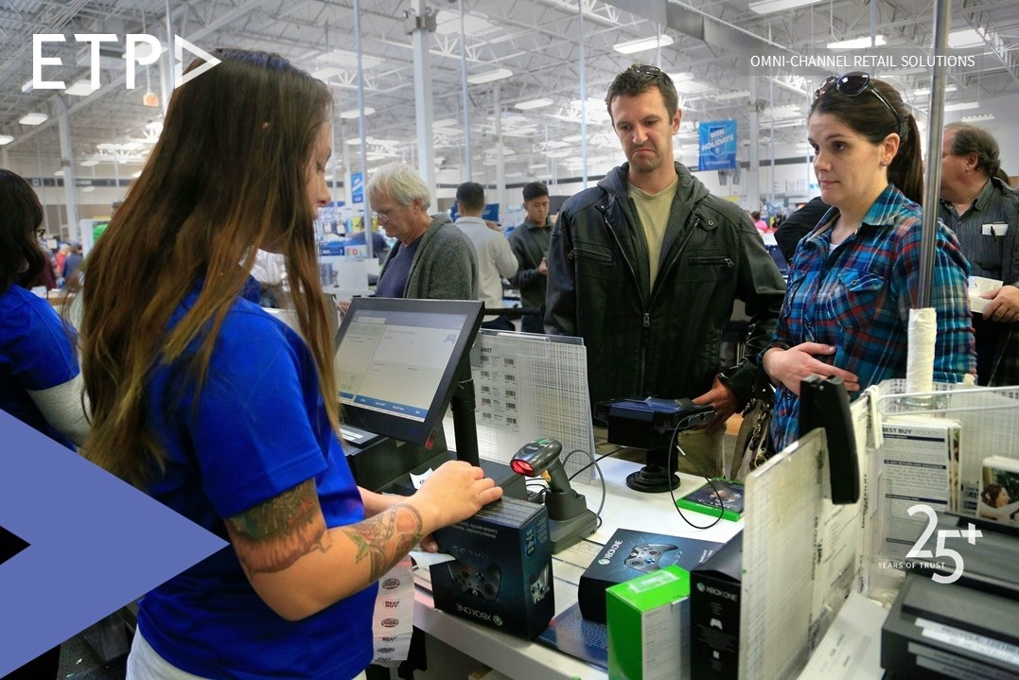
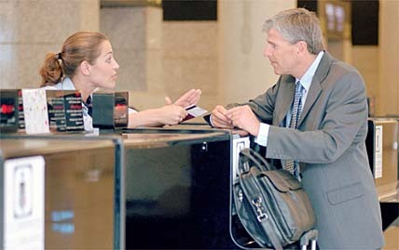
Repeat
When the customer has finished talking, repeat back the key points of the complaint.
This provides confirmation that you were actively listening to the customer, and allows you to summarize what the problem is - in a more neutral way.
Ask any follow-up questions that might clarify what happened.
This level of detailed engagement may further defuse any anger, as it reassures the customer that the complaints are being heard and taken seriously.

Slide 29
Sympathize and Apologize
Even if you disagree with the customer’s perspective, be sure to express sympathy and apologize for what happened.
Keep the apology simple and straightforward.
For example: “That sounds like a difficult experience. I’m sorry, that shouldn’t have happened.”
The goal is to position yourself as being on the customer’s side, which makes it harder for them to continue in conflict.

Slide 30
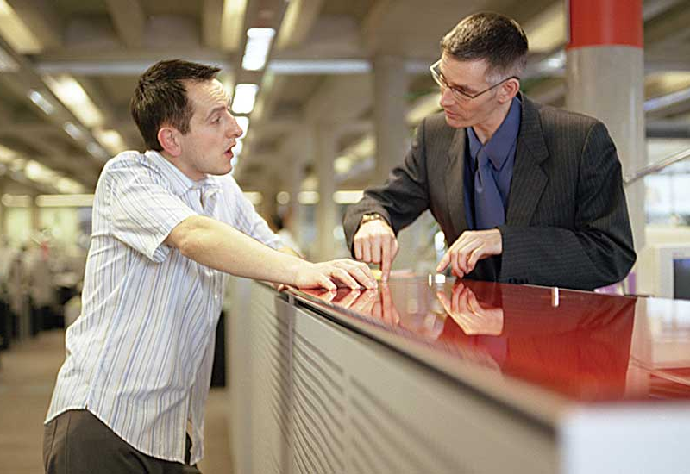
Resolution
Determine what you can do, within your company’s policies, to remediate the problem.
This may involve a refund or exchange; replacement of a damaged product; or a coupon for future purchases.
Give the customer options, if possible, in order to help them feel empowered over a situation that was previously out of their control.
Agreeing on which solution to implement further solidifies that you are working together on the same side, and no longer in conflict.

Slide 31
Knowledge Check
32. What is a factor implicated in many incidents related to violence in the workplace?
The workplace has high stress levels.
The workplace has some workers with a criminal record.
The workplace allows drinking alcohol at lunch.
The workplace requires workers to be in the office four days a week.

Slide 32
Knowledge Check
32. What is a factor implicated in many incidents related to violence in the workplace?
The workplace has high stress levels.
The workplace has some workers with a criminal record.
The workplace allows drinking alcohol at lunch.
The workplace requires workers to be in the office four days a week.

Slide 33
Go the Extra Mile
After the customer’s complaint is resolved, go above and beyond by offering a complimentary product, service, coupon, or voucher.
Once again you show the customer that you are on the same side, looking to help, and there is no need to be in conflict.
Giving the customer an added bonus serves to bring the episode full circle, and leaves the customer with a net positive experience in dealing with your company.

Slide 34
Knowledge Check
In a typical security system, what fundamental security concepts should be incorporated?
Deter, detect, train, respond
Deter, detect, delay, respond
read, react, identify, respond
Deter, detect, delay, dial

Slide 35
Knowledge Check
In a typical security system, what fundamental security concepts should be incorporated?
Deter, detect, train, respond
Deter, detect, delay, respond
read, react, identify, respond
Deter, detect, delay, dial

Slide 36
Questions?

