Slide 1
Chop Saw Safety
OSHA investigated approximately 79 amputations and 10 hospitalizations from 2015-2020 involving Chop / Miter saws.
Manufacturer - SECURE THE WORKPIECE. Use clamps or a vise to hold the workpiece on the table and against the fence or when your hand will be dangerously close to the blade within 6" (152 mm).
This wood is clamped to the table.
Section 5(a)(1)
Notes:
Photo courtesy for Madison machine tool.

Slide 2
Chop Saw Accidents
Getting the glove, or loose-fitting clothing entangled in the chop saw blade.
Hands within 6 inches
Moving hands before blade stops
Wood kickbacks.
This sign would be good to warn employees. 1910.145(c)(3)
Notes:
Sign courtesy of seton sign.

Slide 3
Chop Saw Injuries
12/11/19
Medford WI
An employee was cutting wood stock with a chop saw to fabricate a window when the spinning saw blade amputated the employee's right thumb.
Manufacturer - TURN OFF TOOL AND WAIT FOR SAW BLADE TO STOP BEFORE MOVING WORKPIECE, CHANGING SETTINGS OR MOVING HANDS.
This Saw has the proper guarding
Notes:
Photo courtesy of Baileigh Industrial

Slide 4
Chop Saw Injuries
10/13/2019
New Rochelle NY
An employee was cutting material on a block using a chop saw when the saw kicked back and amputated his left index fingertip.
This miter saw has a blade that needs to be cleaned of excess sap. This caused kickback of the wood. 1910.213(s)(1)

Slide 5
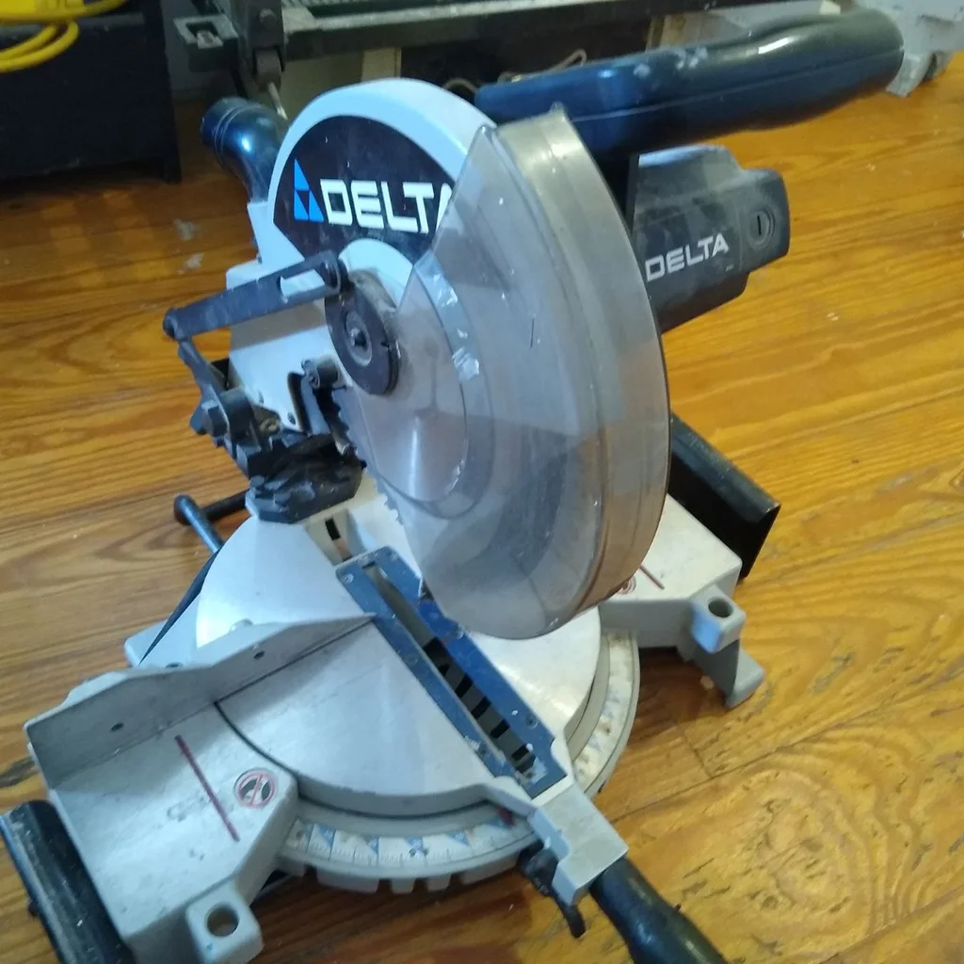
Chop Saw Injuries
9/20/2019
Graceville FL
An employee was using a chop saw to cut boards when the board jammed.
As he was clearing the jam, his right hand came in contact with the blade, resulting in the amputation of his middle and index fingers at the first joint.
The machine was guarded at the time.
This hand is within 6 inches. Lower blade guard is missing.
Manufacturer - KEEP ARMS, HANDS, AND FINGERS AWAY FROM THE BLADE to prevent severe cuts. Clamp all workpieces that would cause your hand to be within 6" (152 mm) of the saw blade. Section 5 (a)(1)

Slide 6
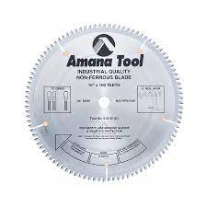
Chop Saw Injuries
2/23/2015
Pampa TX
The employee was cutting a metal stud on a chop saw when the material kicked back and crushed the distal phalanx of the index finger (right hand). They opted to amputate due to the extent of the injury.
Manufacturer NEVER CUT FERROUS METALS (those with any iron or steel content) or masonry.
For cutting non-ferrous metals, use only saw blades with TCG (Triple Chip Grind) teeth designed for this purpose.

Slide 7
Chop Saw Injuries
7/8/2010
Wausau WI
Employee #1 was operating a powered miter box type saw and cutting aluminum I beams.
She was wearing gloves when the saw blade caught the gloves and pulled her fingers into the blade.
The blade amputated her left thumb, and index, middle and ring finger at the distal interphalangeal joint.
Gloves are being worn with this saw. Section 5(a)(1)

Slide 8
General Duty
Section 5(a)(1) of the Occupational Safety and Health Act of 1970: The employer did not furnish employment and a place of employment which were free from recognized hazards that were causing or likely to cause death or serious physical harm to employees in that employees were exposed to finger amputation from glove pulled into a saw blade: On and prior to July 8, 1010, an employee was allowed to wear gloves when operating cut-off/miter box saws, exposing the employee to having the glove inadvertently pulled into the saw blade.
Among other methods, feasible and acceptable means to correct this hazard are to ensure that the DeWALT miter/cut-off saws are used following the manufacturers safety instructions/warnings not to wear gloves and enforce Major Industries safety rule, "do not wear gloves when operating saws".

Slide 9
Some Manufacturers Rules
Follow all instructions in the manual.
Inspect the machine.
OBTAIN ADVICE from your supervisor, instructor, or another qualified person if you are not thoroughly familiar with the operation of this machine. Knowledge is safety.
STABILITY. Make sure the miter saw is placed on a secure supporting surface and does not slip or move during use
ROUND MATERIAL Plastic pipe can be easily cut with your saw. It should be cut just like wood and CLAMPED OR HELD FIRMLY TO THE FENCE TO KEEP IT FROM ROLLING. This is extremely important when making angle cuts.
This pvc pipe is not clamped down and could kick back. Section 5(a)(1)

Slide 10
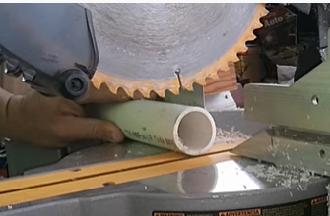
Some Manufacturers Rules
WEAR PROPER APPAREL. Do not wear loose clothing, gloves, neckties, rings, bracelets, or other jewelry which may get caught in moving parts.
Nonslip footwear is recommended.
Wear protective hair covering to contain long hair.
ALWAYS USE SAFETY GLASSES. Everyday eyeglasses are NOT safety glasses. Also use face or dust mask if cutting operation is dusty.
and many many more!
Hands are closer than 6 inches
Section 5(A)(1)
Notes:
Photo courtesy
Tilsatec

Slide 11
Training
OBTAIN ADVICE from your supervisor, instructor, or another qualified person if you are not thoroughly familiar with the operation of this machine.
Knowledge is safety
WARNING: FOR YOUR OWN SAFETY, READ INSTRUCTION MANUAL BEFORE OPERATING MITER SAW.
Let the saw do the work. If you are pushing hard, change the blade.
Unplug saw when changing blade. 1910.147(d)

Slide 12
ANSI
The American National Standards Institute (ANSI) standard
Woodworking Machinery - Safety Requirements
Covers the safety requirements for the design, installation, care and use of woodworking machinery and accessory equipment, used in industrial and commercial applications
OSHA could use Section 5 (a)(1) to cited hazards not in OSHA standards.
Notes:
https://www.osha.gov/publications/hib19920817

