Slide 1
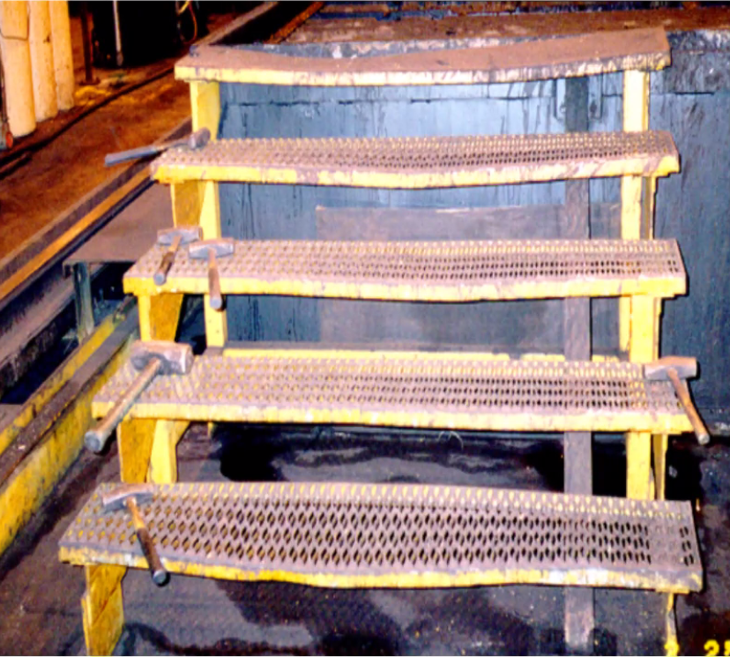
Ladder and Stair Safety
Draft 8 31 2023
An orchard ladder
Notes:
Some data was complete. Some were not. Here is an example of an incomplete one.
Accident 202601290 - Fall From Ladder
Accident 202601290 -- Report ID: 0950633 -- Event Date: 01/31/2010
Inspection: 313507899 Open: 03/10/2010 SIC: 7623 Upland Air
No injury (no jurisdiction)
Inspection Age Sex Degree Nature Occupation Construction
1 313507899 Jeff Tomsett
54 M Fatality Fracture Machinery Maintenance Occupations

Slide 2
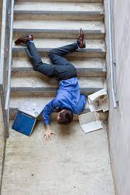
2022
6 Stair Fatals and Dozens of falls.
Cell Phones
Carrying Objects
Use Handrails
Do you have a Tool Box Talk on these Three Issues?

Slide 3
May 2017

Slide 4
May 2022

Slide 5
May 2022

Slide 6
April 2019

Slide 7
April 2019

Slide 8
Transitions

Slide 9
Stairways
1926.1052(a)(6)&(7)
Free of nails
No slippery conditions

Slide 10
Stairways
1926.1052(b)(1)&(3)
Pan stairs filled
Full length and depth

Slide 11
Obstructions

Slide 12
Stairways
1926.1052(c)(1)(i)-(iii)
Four or more risers
Stair rail
Hand rail

Slide 13
Stairways
1926.1052(c)(3)(i)&(ii)
The height of stairrails shall be not less than 36 inches

Slide 14
Stairways
1926.1052(c)(4)(i)
Midrails are required

Slide 15
Stairways
1926.1052(c)(6)&(7)
Handrails 30-37 inches
If the top rail is both a stairrail and handrail then it is 36-37 inches

Slide 16
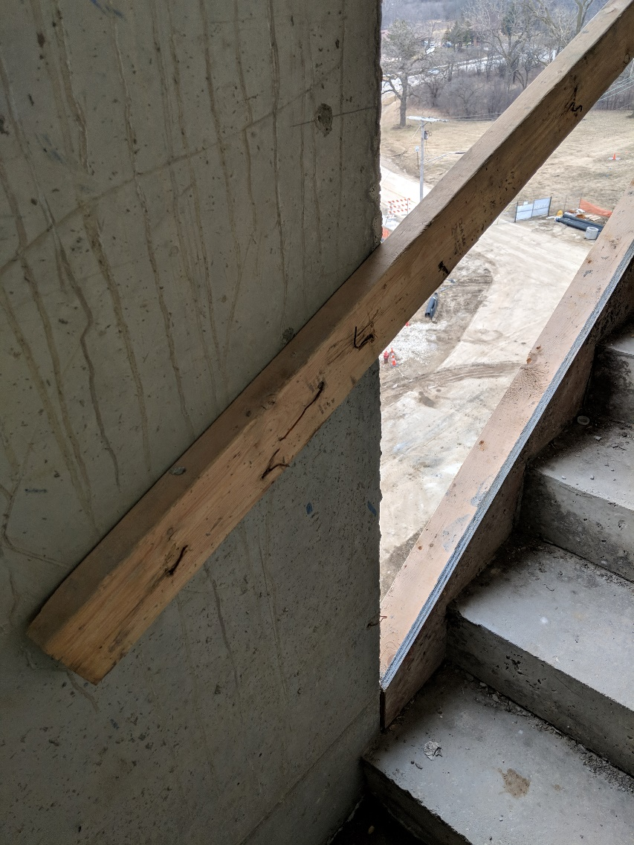
Stairways
1926.1052(c)(8)
Smooth rails

Slide 17
Stairways
1926.1052(c)(8)
Handrails that will not be a permanent part of the structure being built shall have a minimum clearance of 3 inches between the handrail and walls,

Slide 18
Stairways
1926.1052(c)(12)
Stairway landings have guardrails

Slide 19
Crossovers
Manny Commercial solutions are available.

Slide 20
Questions

