Slide 1
CDL Safety
johnanewquist@gmail.com

Slide 2
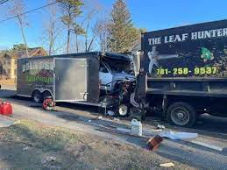
March 2024
The Kia Sorento drove off the road and collided with a landscaping truck.

Slide 3
Inspection

Slide 4
Inspection

Slide 5
Inspection

Slide 6
Inspection

Slide 7
Inspection

Slide 8
Inspection

Slide 9
Inspection

Slide 10
Inspection

Slide 11
Inspection

Slide 12
Inspection

Slide 13
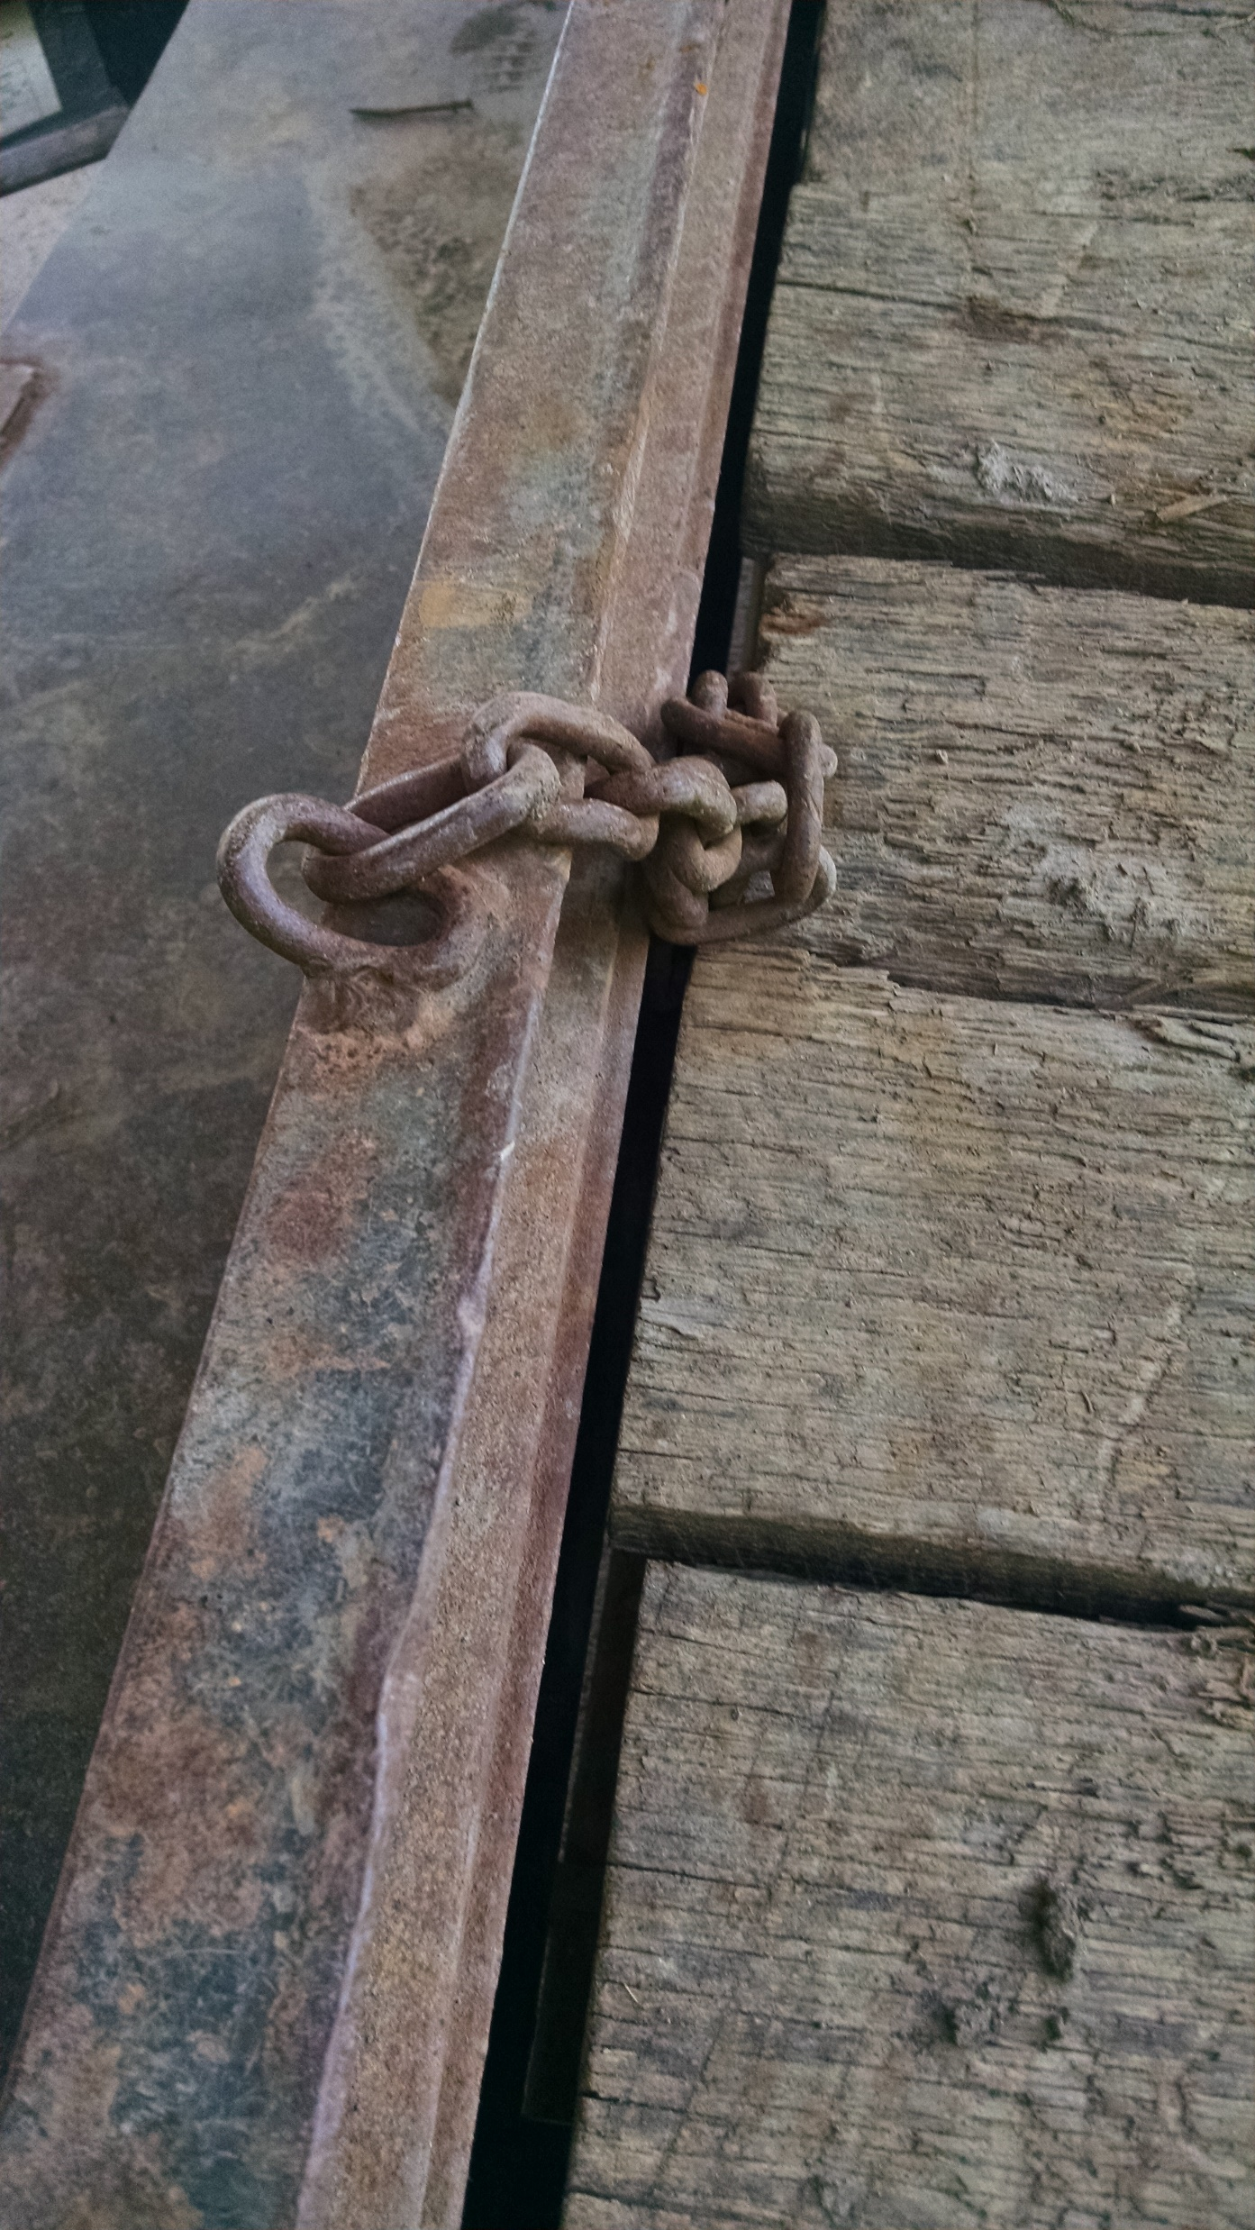
Inspection

Slide 14
Clearance
Birmingham AL
the driver of the U-Haul was trying to enter the parking deck but did not have the height clearance to do so.
The top of the truck hit the beam, which caused it to collapse. The beam came crashing down on the cab of the truck.

Slide 15
Criss Cross Chains – No China chain

Slide 16
Sleep
7% of all crashes
Driver fatigue is believed to cause 100,000 police-reported crashes annually with 1,550 deaths, 71,000 injuries, and $12.5 billion in monetary losses
Individuals who sleep fewer than six hours a night on average have a 13 per cent higher mortality risk than people who sleep at least seven hours.
U.S. sustains by far the highest economic losses up to $411 billion a year or 2.26% GDP
U.S. loses an equivalent of around 1.2 million working days due to insufficient sleep.
Est. Incidence Rate per Chronobiology
Less than 5 hours – 7.89
5-6 hours – 5.21
6-7 hours – 3.62
7-8 hours - 2.27
8-9 hours - 2.50

Slide 17
Sleep
Individuals could:
Set consistent wake-up times;
Limit the use of electronic items before bedtime;
Eat 2-3 hours before bedtime
Exercise Regular
Sleep medication

Slide 18
Sleep Medications

Slide 19
October 2014
Delivery Driver strikes pedestrian in center turn lane

Slide 20
Right turn only

Slide 21
Road Rage
45.4% was another driver angrily honking their horn.
38.9% other drivers signaling rude hand gestures
30% another driver driving while distracted with their phone.
Attacker said other women cut her off.
2 years in jail.

Slide 22
Road Rage
2021 - someone has been shot and killed or injured in a road rage incident on average every 18 hours
50% of all car crashes that end in fatality
Ongoing two felony counts.

Slide 23
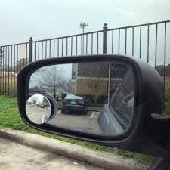
Backing up issues

Slide 24
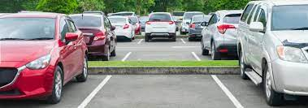
Backing up Techniques
Pull forward parking
Think twice, look twice
Minimize distractions – music, cell phone
Slow 5 mph speed
Honk if blind spots
Reverse Camera

Slide 25
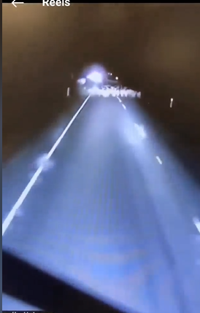
“Over driving your headlights.”
Very common.
When you can’t stop in the distance you can see.
Why pile ups happen in fog.

Slide 26
Sun
June 18, 2021
A Worker was hit yesterday in the parking lot by a pickup driven by another worker.
Suggestions?

Slide 27
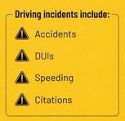
Stats
Notes:
Lending tree jan 2024

Slide 28
Driving on Ice
Slow down:
Avoid sudden movements: Avoid sudden acceleration, deceleration, and sharp turns.
Brake gently: Brake to prevent skidding, and use engine braking when possible.
Watch for black ice:
Keep your distance
Lights on in day

Slide 29
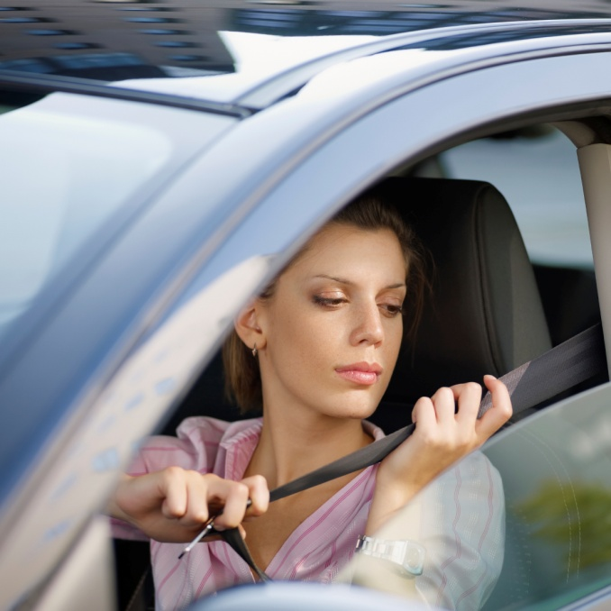
Top Six Driver Errors
Failure to wear a seatbelt
Excessive speeding
Distraction/inattentiveness - eating, drinking, smoking, radio, cell phone..
Incorrect assumptions about other drivers
Tailgating/not leaving enough space between vehicles
Not checking traffic before pulling out or crossing lanes
Notes:
Seatbelt- you are 25 times more likely to be killed or seriously injured when thrown clear into the air
50% of people who die in motor vehicle crashes could have been saved had they worn a seatbelt
Driver distraction is one out of 6 we have here, but it’s one we need to focus on because of the growing danger of driver distractions
According to the Trauma Society, distracted driving is a national epidemic that killed more than 6,000 people in 2008

Slide 30
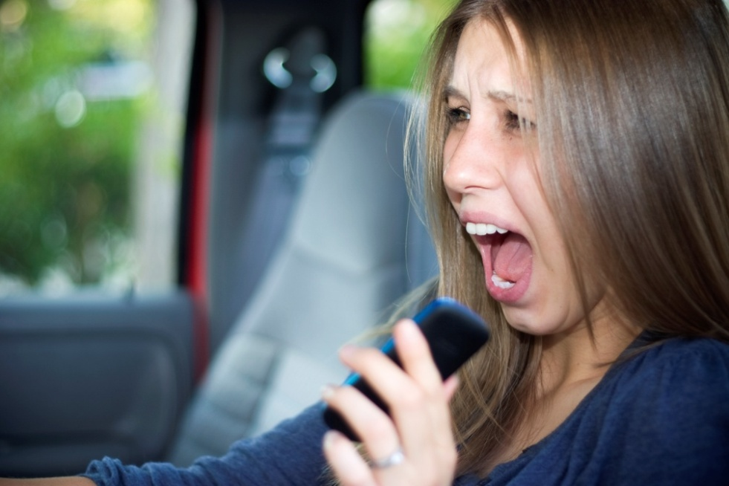
Cell Phones: A Distraction Like No Other
Talking on cell phones increases crash risk 4x
More than 100 million people are talking while driving
11% of all drivers at any moment
Result: 1.4 million crashes/year
(25% of all crashes)
are caused by cell phone use.
Notes:
©National Safety Council 2010
30

Slide 31
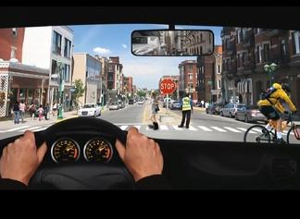
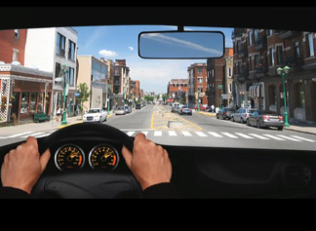
Inattention Blindness
What a driver in a simulator saw when
not using a phone.
What the same driver saw while on a phone conversation.
Notes:
National Safety Council
Cell Phone Use While Driving
31

Slide 32
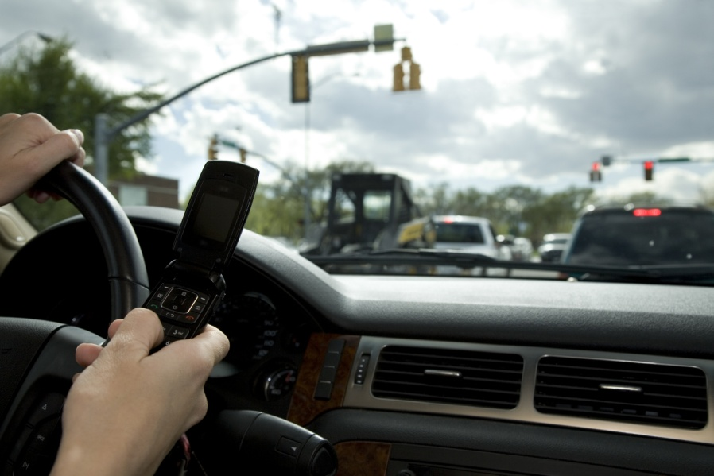
Texting while Driving
Texting while driving = 6 times more likely to result in an accident than
driving while intoxicated
Texting while driving brings eyes off the
road an average of 4.6 out of 6 seconds
At 55 MPH, one would travel the length of
a football field, including the end zones,
without looking at the road

Slide 33
Speed
In 2019, speeding killed 9,478 people.
26% of all deaths
Covid 2020, less traffic,
People drove faster

Slide 34
Road Rage Calm Down
Safe driving starts the night before with adequate sleep.
Recognize your rising anger
Deep Breathe.
Hold breath 5 seconds.
Listen to calming music.
Count to 60.

Slide 35
Safe Distance
Three-second following distance
Recognize people will cut into the space.

Slide 36
Backing up
500,000 backing accidents of some type
15,000 Included some sort of injury
210 people are killed annually from backing accidents, mostly children under the age of 5 (31% of all fatalities).

Slide 37
Backing up issues

Slide 38
Backing up Techniques
Pull forward parking
Think twice, look twice
Minimize distractions – music, cell phone
Slow 5 mph speed
Honk if blind spots
Reverse Camera

Slide 39
Top Ten States for Deer Crashes
1) Pennsylvania 2) Michigan 3) Illinois 4) Ohio 5) Georgia 6) Minnesota 7) Virginia 8) Indiana 9) Texas 10) Wisconsin
Notes:
Notes: The number of accidents increases with the deer migrating and mating season which occurs between the months of October and December
References: An insurance claims statistics study conducted in 2004-2005, on www.Car-Accidents.com

Slide 40
Deer Crash Photos

Slide 41
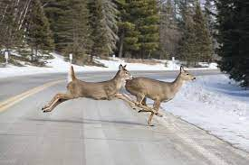
Avoiding Deer Crashes
Most deer crash deaths and serious injuries occur when motorists veer to avoid hitting deer
Improve your vision
Slow down in marked deer caution zones
Drive within the range of your headlights
Use of high-beam headlights when driving in deer territory will increase your vision and increase your time to react
Notes:
References: Iowa Department of Public Safety

Slide 42
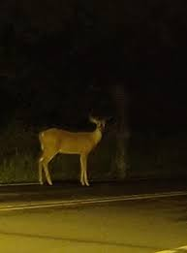
Avoiding Deer Crashes
Watch for Deer
Dusk to dawn
Spring and Fall
Near waterways
Near wooded areas
Notes:
References: Iowa Department of Public Safety

Slide 43
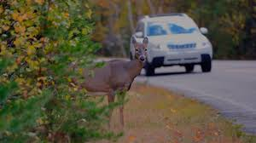
Avoiding Deer Crashes
Remember……
Deer are unpredictable
Deer travel in groups, so watch for more than one
Don’t Veer
Off the roadway
Out of control
Into oncoming traffic
Notes:
References: Iowa Department of Public Safety

Slide 44
Cab is Clean

Slide 45
Chock the Wheels

Slide 46
Fires

Slide 47
Hours of Service

Slide 48
Questions?

