Slide 1
Liquid Nitrogen Safety
John Newquist
johnanewquist@gmail.com
Aug 2022

Slide 2
Objectives
Workers will be able explain two hazards of liquid nitrogen
Worker will be able select correct PPE for transferring liquid nitrogen
Workers will be able identify two precautions needed of using liquid nitrogen in cooling concrete.

Slide 3
Clean Air Paradox
Quality of Air
78.1% Nitrogen
20.9% Oxygen
0.9% Argon
0.03% Carbon Dioxide

Slide 4
What are Cryogenics
All cryogenic liquids are gases at room temperature and atmospheric pressure.
The gases are liquefied at very low temperature and high pressures.
Cryogenic liquids are materials with boiling points of less than 73 C (100 F).

Slide 5
Properties
Extremely cold in liquid state
Small quantities of liquid may expand to large volumes of gas
Expansion Ratio, (liquid to gas) 1 to 694

Slide 6
Common Cryogenics
Liquid Nitrogen
Liquid Helium
Dry Ice (Carbon Dioxide)

Slide 7
Liquid Nitrogen
Liquid Nitrogen is heavier than air, inert, colorless, non-corrosive, non-flammable, and extremely cold.
Boiling Point at 1atm is -195.8C/-320.4F/77K
Under certain conditions, nitrogen can react violently with lithium, neodymium, titanium (above 1472F/800C), and magnesium to form nitrides.

Slide 8
Hazards
Extreme Cold - Frostbite
Oxygen Deficiency - Asphyxiation
Over Pressurization - Physical Injury

Slide 9
Exposure
Directly touching the liquid with your skin
Indirectly touching something cooled by the cryogenic liquid like a metal transfer line
Indirectly by exposing skin or eyes to the cold gas coming out of a pressure relief valve at the end of a transfer line

Slide 10
Extreme Cold Hazards
Cyrogenic liquids and cold vapors can cause thermal burn injuries, frostbite.
Brief exposures may damage tissue.
Breathing extremely cold air may damage lungs.
Skin may stick to metal that is cooled by cryogenic liquids and when pulled away the skin may tear.
Non-metallic materials are also dangerous to touch at cryogenic temperatures.

Slide 11
Oxygen Deficiency (Asphyxiation)
Occurs without any warning
Due to oxygen displacement
Cryogenic liquid warms up it becomes a gas, the gas is still very cold.
Liquid N2 gas is heavier than air.
Increased hazards associated with large volumes of cryogens in small spaces.

Slide 12
Over Pressurization – Hazard
Without adequate venting or pressure-relief devices on closed containers containing cryogens, enormous pressures can build up.
The pressure may cause an explosion.
The pressure relief valve must be properly installed and free from obstruction.

Slide 13
Cryogen Safety Guidelines
Equipment should be kept clean.
Perform routine inspections of all safety equipment and cryogenic systems.
Mixtures of gases or fluids should be strictly controlled to prevent formation of flammable or explosive mixtures.
Containers and systems containing cryogens should have pressure relief mechanisms.

Slide 14
Cryogen Safety Guidelines
Ensure that all pressure relief valves and rupture disk vent paths are directed away from personnel.
Containers and systems should be capable of withstanding extreme cold without becoming brittle.
Glass containers should be taped solidly around the outside or encased in plastic mesh.
Funnels should not be used for pouring liquid nitrogen or any other cryogen.
What hazards?

Slide 15
Knowledge Check
Two hazards of liquid nitrogen are:
Flammable
Very Cold Liquid
Poisonous at 1 ppm
Asphyxiation
Cancerous

Slide 16
Knowledge Check
Two hazards of liquid nitrogen are:
Flammable
Very Cold Liquid
Poisonous at 1 ppm
Asphyxiation
Cancerous

Slide 17
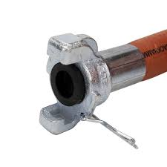
2016 Death
CANTON, Ohio -- After a 32-year-old male worker was found dead in a control-room at Timken Steel's Faircrest Plant on Sunday, the U.S. Department of Labor's Occupational Safety and Health Administration's Cleveland office said that the worker may have been exposed to too much nitrogen.
"Companies that have nitrogen systems need to make sure that they recognize the hazard of oxygen deficiency that can be created by its ability to displace oxygen," Howard Eberts, OSHA's Area Director in Cleveland.

Slide 18
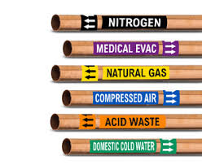
Citation
Pipes need to be labeled!

Slide 19
Nov 2018
3 Dead in cryogenic cooler room.
Alberta Canada
Liquid Nitrogen
Cited - written code of practice for working in the confined space of the cryogenic coolers,
Establish an emergency response plan for responding to an emergency that may require rescue or evacuation and
Designate a competent worker to conduct hazard assessments related to working in confined spaces.

Slide 20
2020 Death
Jan. 28
Georgia
Six people were killed and at least a dozen others were injured in what was determined to be a nitrogen leak at Foundation Food Group poultry processing plant

Slide 21
OSHA
Over $1,000,000 to Contractors and Foundation Foods
In Contest
Lockout Procedure for the freezer
PPE Hazard Assessment
Hazcom - Labels for Nitrogen Hazard
Hazcom - Asphyxiation hazard of Nitrogen

Slide 22
Citation General Duty

Slide 23
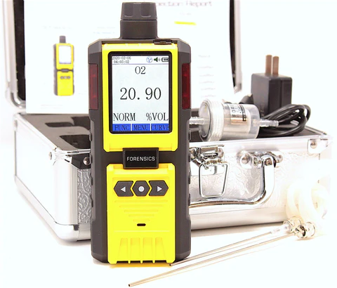
Nitrogen
When the oxygen concentration in air is sufficiently low, a person can become unconscious without any warning symptoms.
Fixed oxygen detector
Handheld oxygen detector
Notes:
https://www.rkiinstruments.com/blog/detector-heads/nitrogen-storage-monitoring/?utm_source=google&utm_medium=cpc&utm_campaign=RKI_DSA_Prospecting&utm_content=all%20web%20pages&utm_term=&gclid=Cj0KCQjw8O-VBhCpARIsACMvVLNiZD76uIW_HVMuY76-s2lst_A5oRrUniPDSoB_pqUbIybkzgwwDtUaAtMwEALw_wcB

Slide 24
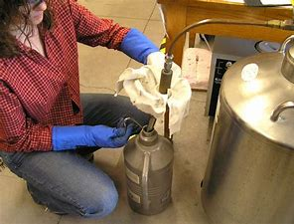
CGA-Liquid Nitrogen Safety
Wear appropriate personal protective equipment (PPE)

Slide 25
CGA-Liquid Nitrogen Safety
Do not lower your head into a liquid nitrogen vapor cloud
Only use containers and equipment designed for cryogenic service
Never trap liquid nitrogen in a container, tubing, or piping

Slide 26
CGA-Liquid Nitrogen Safety
Read and understand safety information prior to using liquid nitrogen
Use liquid nitrogen in well-ventilated areas

Slide 27
Cool Concrete With Liquid Nitrogen Injection
Maintain low, uniform temperature specifications including less than 50°F, at any production rate
Realize accurate and flexible temperature adjustments greater than 50°F
No adverse impact on slump, air content, set time or density
Reduce delays and safety risks associated with handling ice, no need to purchase a refrigeration system

Slide 28
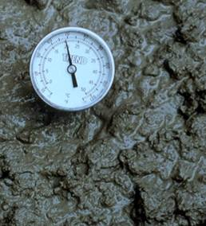
Concrete & Temperature
Test on site using a thermometer
Pumping adds heat, so test at end of pump
Use ice or liquid nitrogen in summer
Use hot water or steam in winter

Slide 29
Knowledge Check
Which of the following PPE would be worn if dispensing liquid nitrogen?
Gloves
Face Shield
Safety Glasses or Safety Goggles
Clothing that coves the skin
Steel toes shoes

Slide 30
Knowledge Check
Which of the following PPE would be worn if dispensing liquid nitrogen?
Gloves
Face Shield
Safety Glasses or Safety Goggles
Clothing that coves the skin
Steel toes shoes

Slide 31
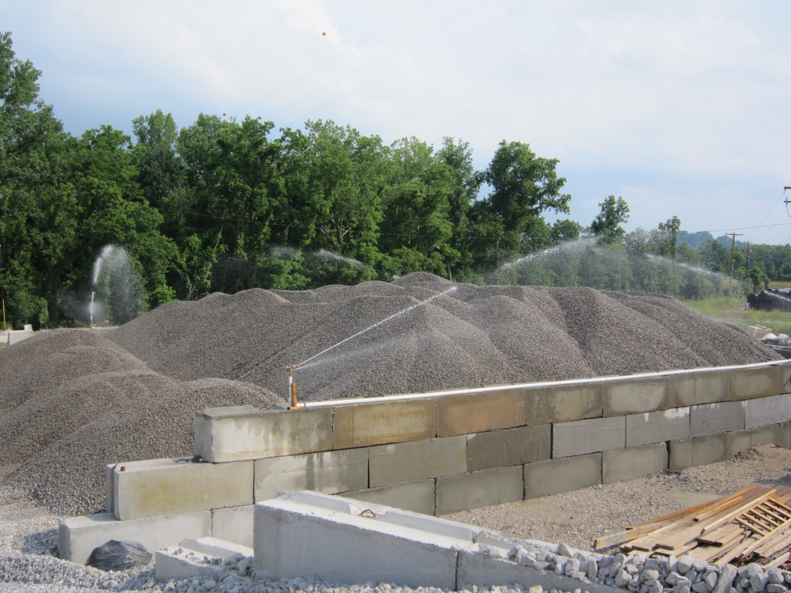
Photo courtesy:
Michael Gong

Slide 32
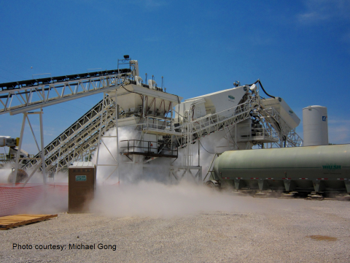
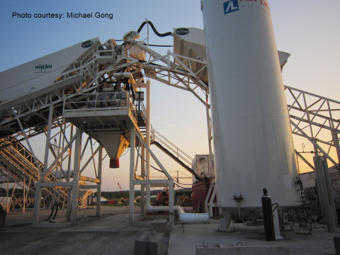
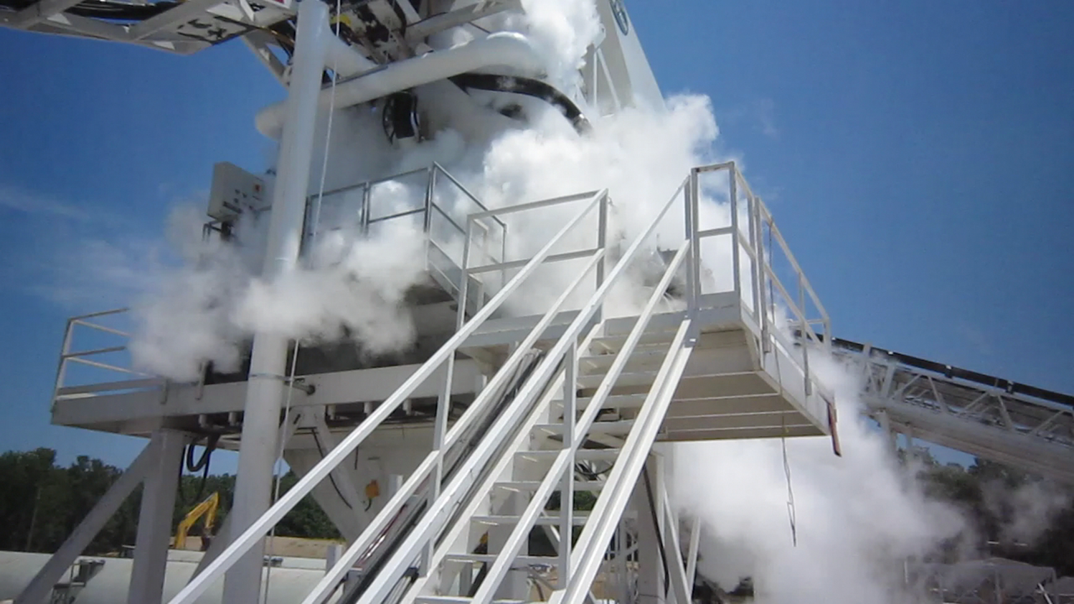
Hazard?
Liquid Nitrogen
-321° Fahrenheit
Notes:
Cannelton Hydroelectric Generation Plant, Hawesville, KY. Liquid nitrogen is being introduced to the concrete to cool the mix to less than 50 degrees Fahrenheit

Slide 33
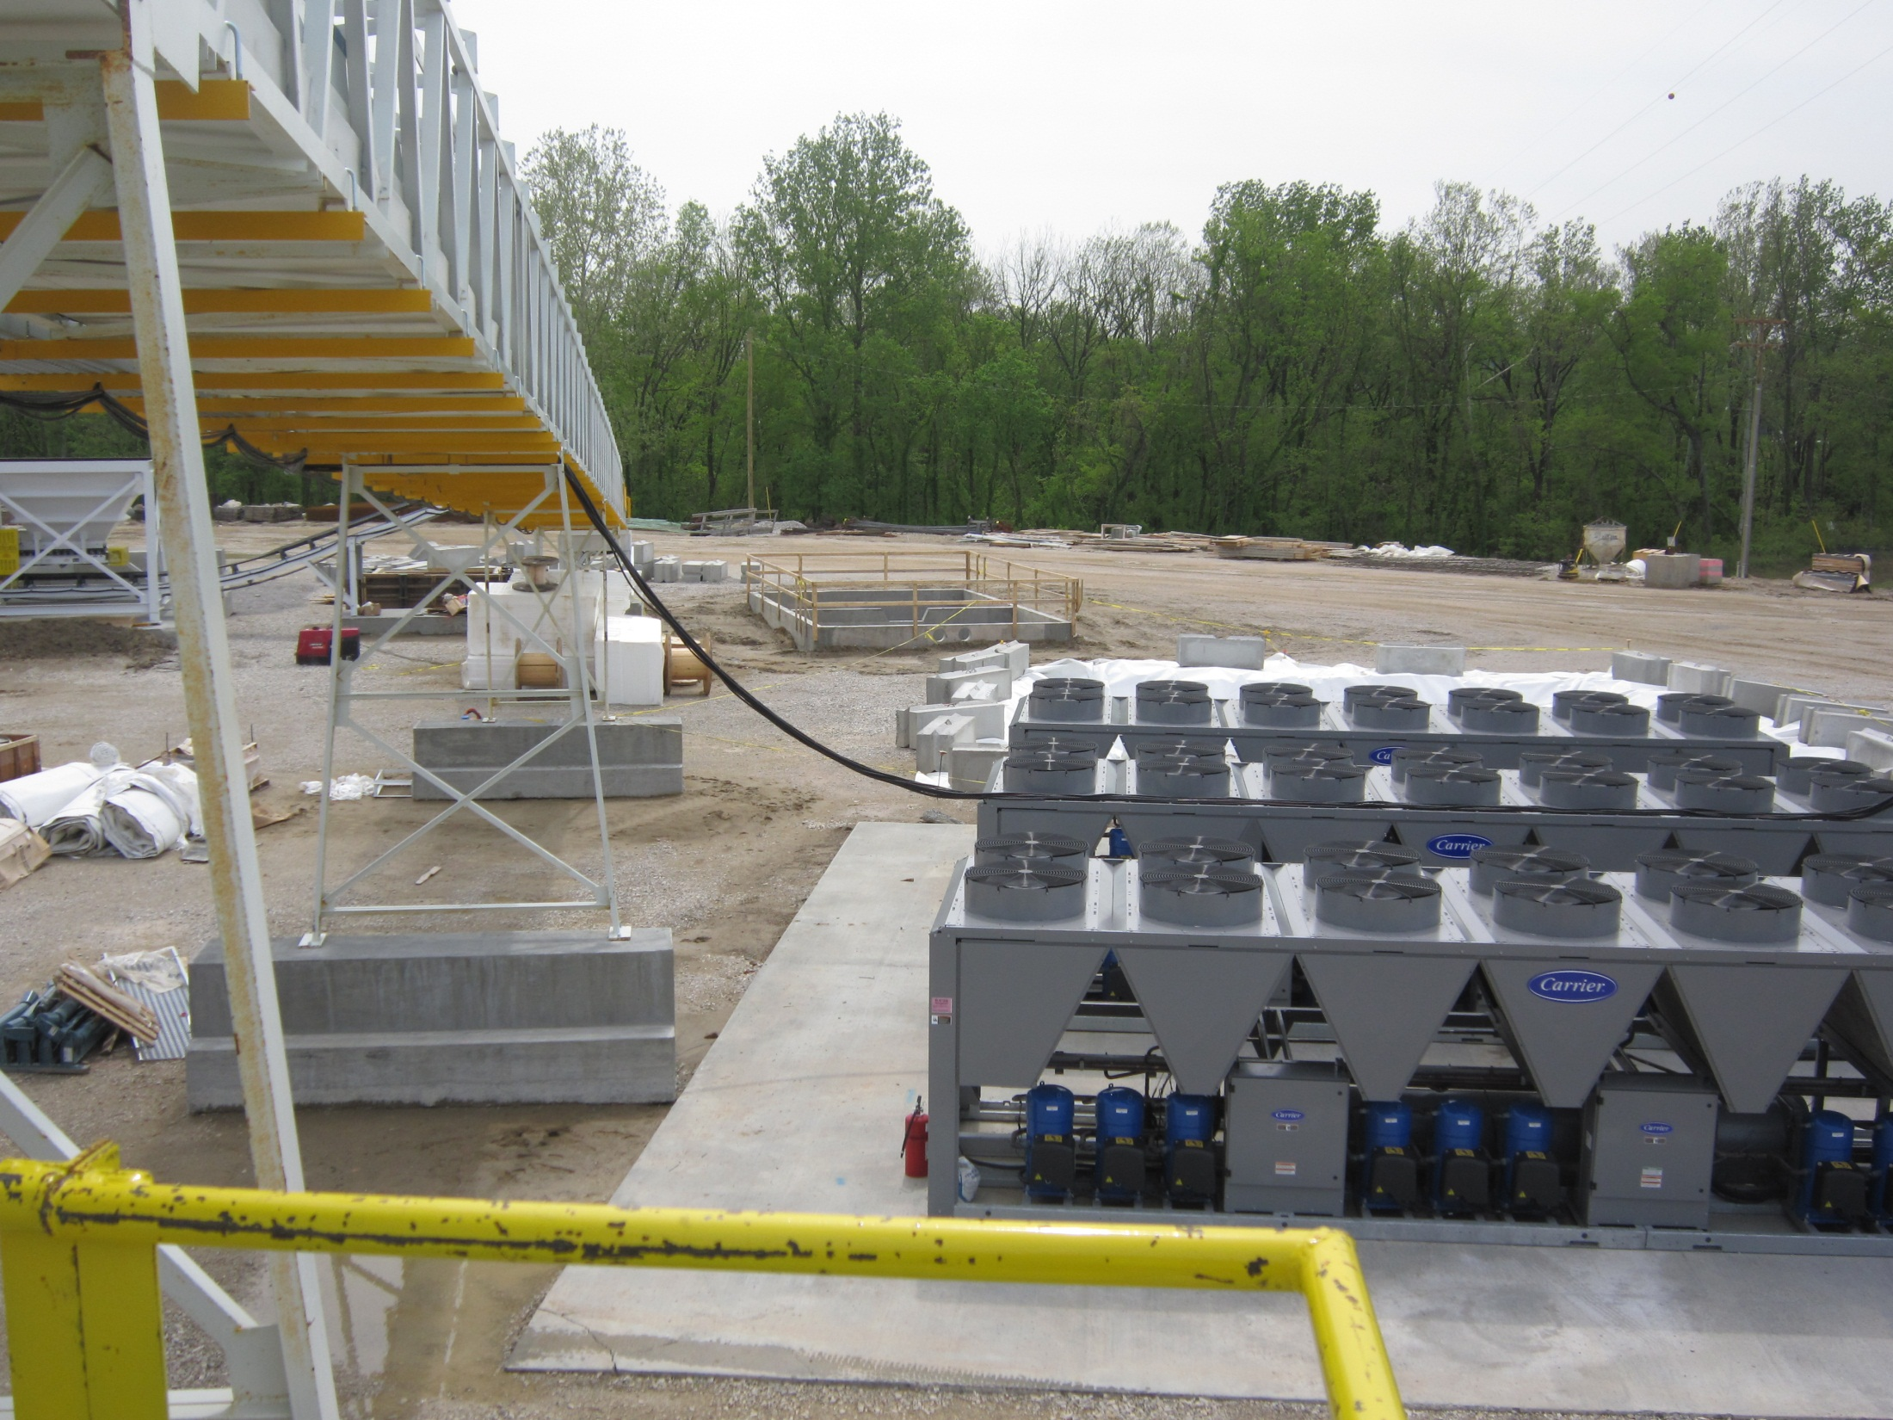
Photo courtesy: Michael Gong
Recommendations?

Slide 34
Take Aways
Ask Questions about oxygen alarms
Can you be sprayed or contact liquid nitrogen?
Is there safe egress to fresh air?
Are lines marked for content?

Slide 35
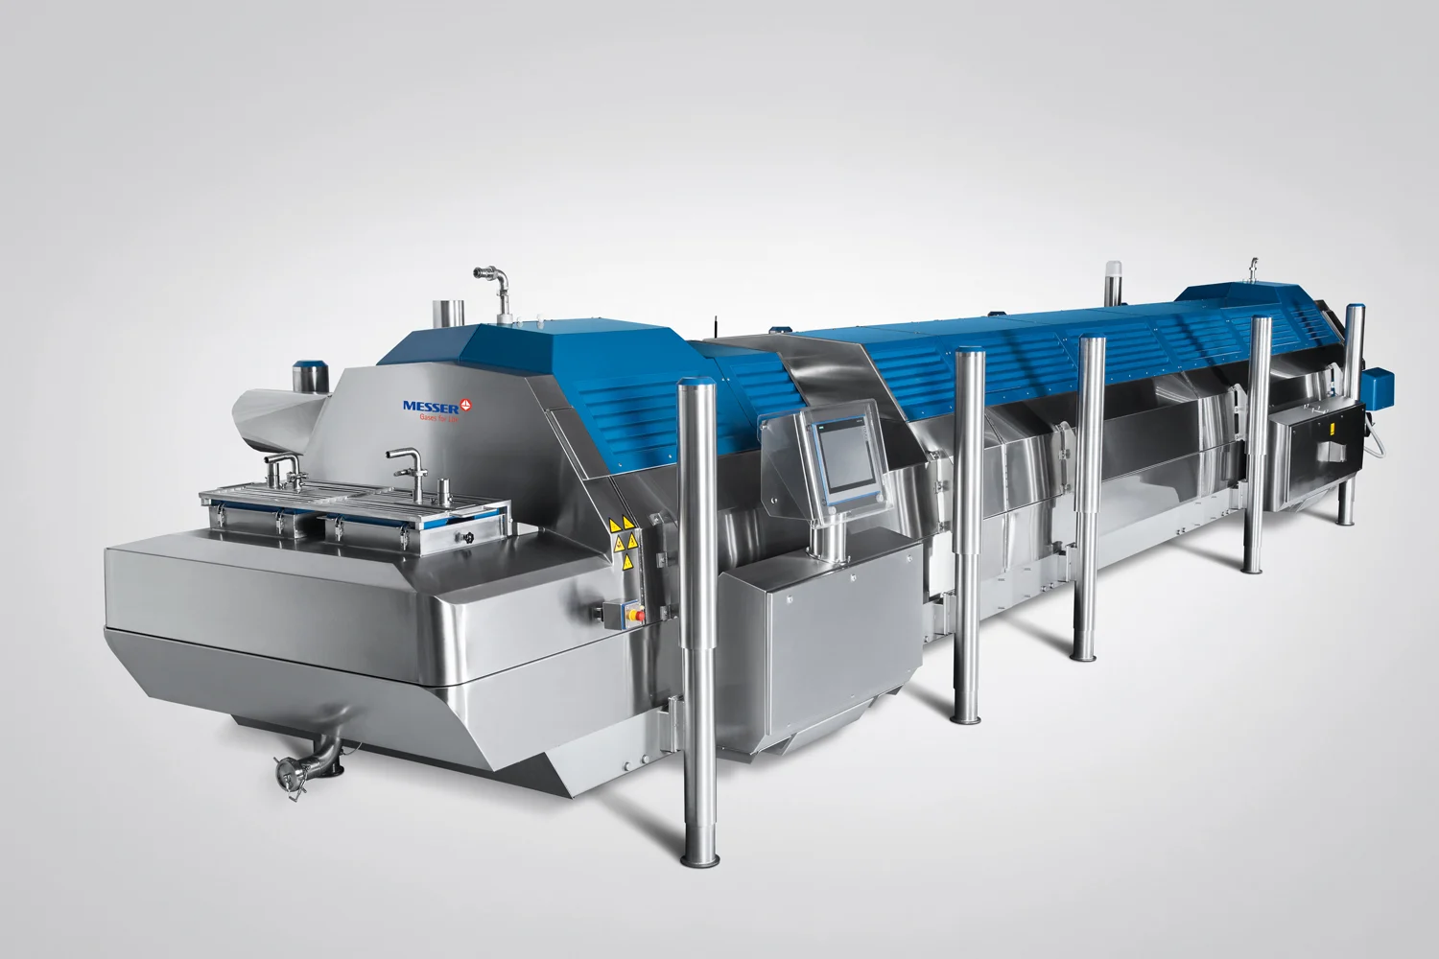
Summary
Oxygen alarms personal and fixed
Ventilation
Signs for isolation valves
Procedures: startup, shutdown and emergency shutdown,
Respirator when uncertain air quality
Nitrogen vessel inspected and certified
Cryogenic Food Freezing

